Slide 1



WELCOME TO
CT24
THE VOICE OF
THE PASSENGER

Slide 2
Welcome
VICTORIA ARMSTRONG
CTA CHIEF EXECUTIVE
#CT24

Slide 3
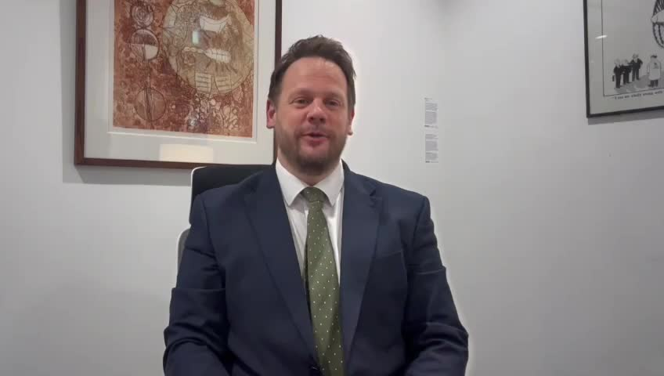

Slide 4
Growing and supporting
the sector
VICTORIA ARMSTRONG
CTA CHIEF EXECUTIVE
#CT24

Slide 5

Unlock your CTO’s
Social Value
JOHN CHESTERS
EALING COMMUNITY
TRANSPORT
#CT24

Slide 6

Community Transport Social Value Toolkit
John Chesters
CEO
ECT Charity

Slide 7
CT role in the transport sector
Over 55% of users are geographically isolated
  Community Transport has existed since 1960s
  Assisting individuals to live independently and encourage social integration for wellbeing and community benefit
  Critical role in enabling travel for vulnerable or isolated individuals providing, at least, half a million trips monthly in England alone.
  Poor recognition of CT with the benefits it brings to individuals and society in wider transport conversations
Since 1985, CT sector has seen growth
Most frequent destination for users is to health appointments

Slide 8
Sector Priorities
Staffing and Volunteer Shortages
Funding cuts
Rising operational costs

Slide 9
Sector at risk
Under resourcing
Closure of public services
Sparse data
Ageing population
Under representation in policy

Slide 10
Social Value
aka Public Value
    The social, environmental and economic benefits of an organisation, project or intervention
Increasing regulation of social value
    Legislations to incorporate social value with the aim of improving societal outcomes
Government Social Value model currently covers 5 themes
    Linked to Government priority policy outcomes

Slide 11
Community Transport Social Value
COVID-19 recovery
Tackling economic inequality
The 5 themes of the Government's Social Value model present an opportunity for CTs to demonstrate their societal worth
Fighting climate change
Equal opportunity
Wellbeing

Slide 12
Community Transport Social Value Toolkit
Inform CT decision making
The CT Social Value Toolkit is an instrument that can be used by CTs to demonstrate societal worth
Motivate CT volunteers and employees
Demonstrate impact of CT services
Communicate the need and case for CT to funders and government

Slide 13
Community Transport Social Value Toolkit
  Since 2015, significant developments and updates with the latest version 2.0 now available
  Ability to now collate data from members of the scheme nationally
  PowerBI compiles annual data of members
  Data from all sizes of organisations is key to understanding the impacts of CT services across the UK
  Results generated can provide clarity and direction to CTs in demonstrating the value of their services beyond the economic benefits aka the social value
To access the toolkit or find out more: socialvalue@ectcharity.co.uk

Slide 14
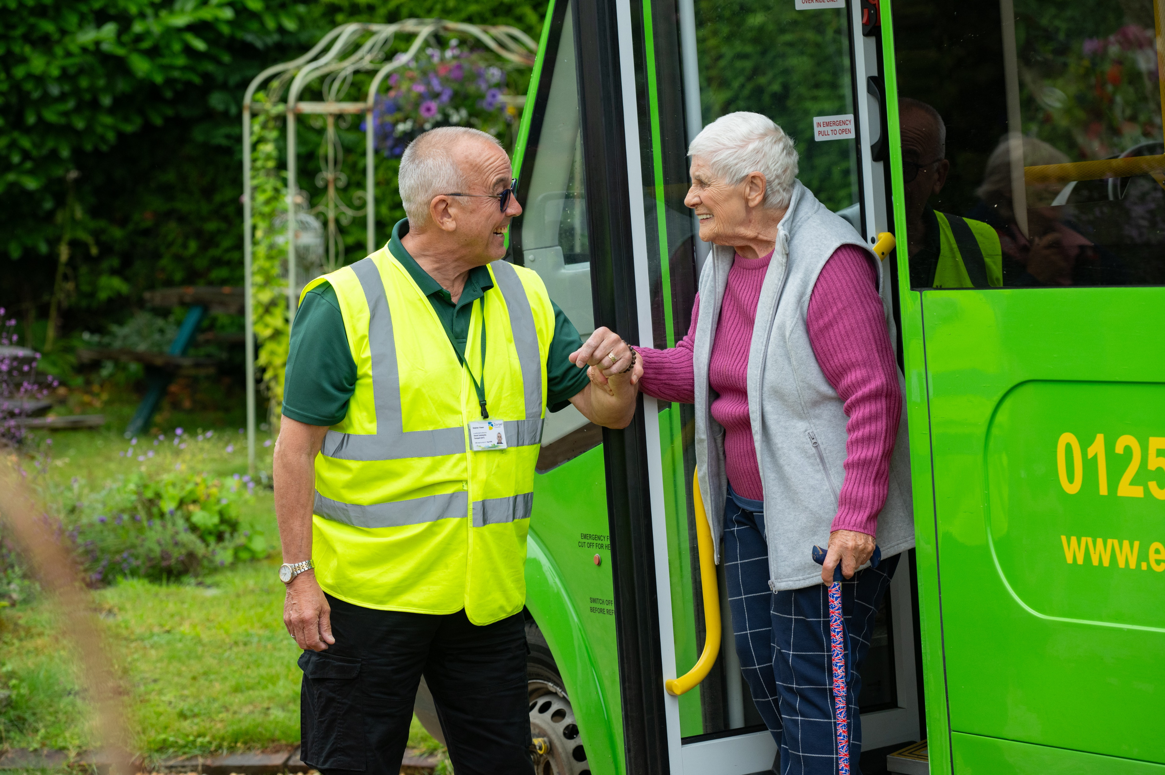



Slide 15
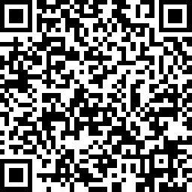
Apply Here
Social Value Research Project
Caroline Whitney
Director for England, CTA
#CT24

Slide 16

Objectives of the Project
Apply Here
Overarching Objective
Generate a Social Value Return Figure for the CT Sector in the UK
and utilise this to promote the value of the sector with stakeholders including local, regional and national government.
Deliverables
  Case studies demonstrating impact on the tool kit from CT Operators, Stakeholders and Funders
  Resources and tools to support CT sector in increasing their skills and knowledge in;
    General data collection,
    Simple data analysis and,
    How to use the results to influence stakeholders

Slide 17
We will..
Apply Here
Recruit up to 100 community transport operators from across the UK to use the toolkit
Deliver a Support offer
  Discounted access to the toolkit
  1-2-1 Support from CTA and ECT to ensure organisations can complete the data
  Access to 3 webinars focused on
    Data Collection
    Data Analysis
    Using data to influence stakeholders
Annual Turnover | Toolkit Cost | CTA Contribution | CTO contribution
£0 - £249,999 | £50 | £25 | £25
£250,000 - £999,999 | £100 | £50 | £50
£1 million and above | £200 | £100 | £100

Slide 18
How to be involved
Apply Here
Register for the project
Selection criteria
  Hold a current CTA Membership with agreement to ensure this remains active during the 12months of accessing the toolkit
  Currently operate within the UK and have delivered services for 12 months
  Initial priority given to Primary Operators or Secondary with a significant CT Operation.
  Have some data collection methods in place currently
  Actions for operators
  To complete at least 12 months data into the Social Value toolkit – Latest date for first sharing data – End of April 2024

Slide 19
Timeline
Application process
November – January
Initial organisations selected by Mid Dec
Access to the toolkit and initial induction
January 25
First set of monthly data inputted
Dec – End of April 25
Remaining data input to cover 12 months from the first date
Monthly data input April – June
Quarterly Data input July 25 – March 26
Webinar programme
Feb – July 25
Ongoing 1-2-1 support from CTA
Apply Here

Slide 20
Come and talk to us at the stand
Apply Here

Slide 21

What do you know
about Community Transport?
DYLAN GALLANDERS
TRAINING MANAGER, CTA
#CT24

Slide 22
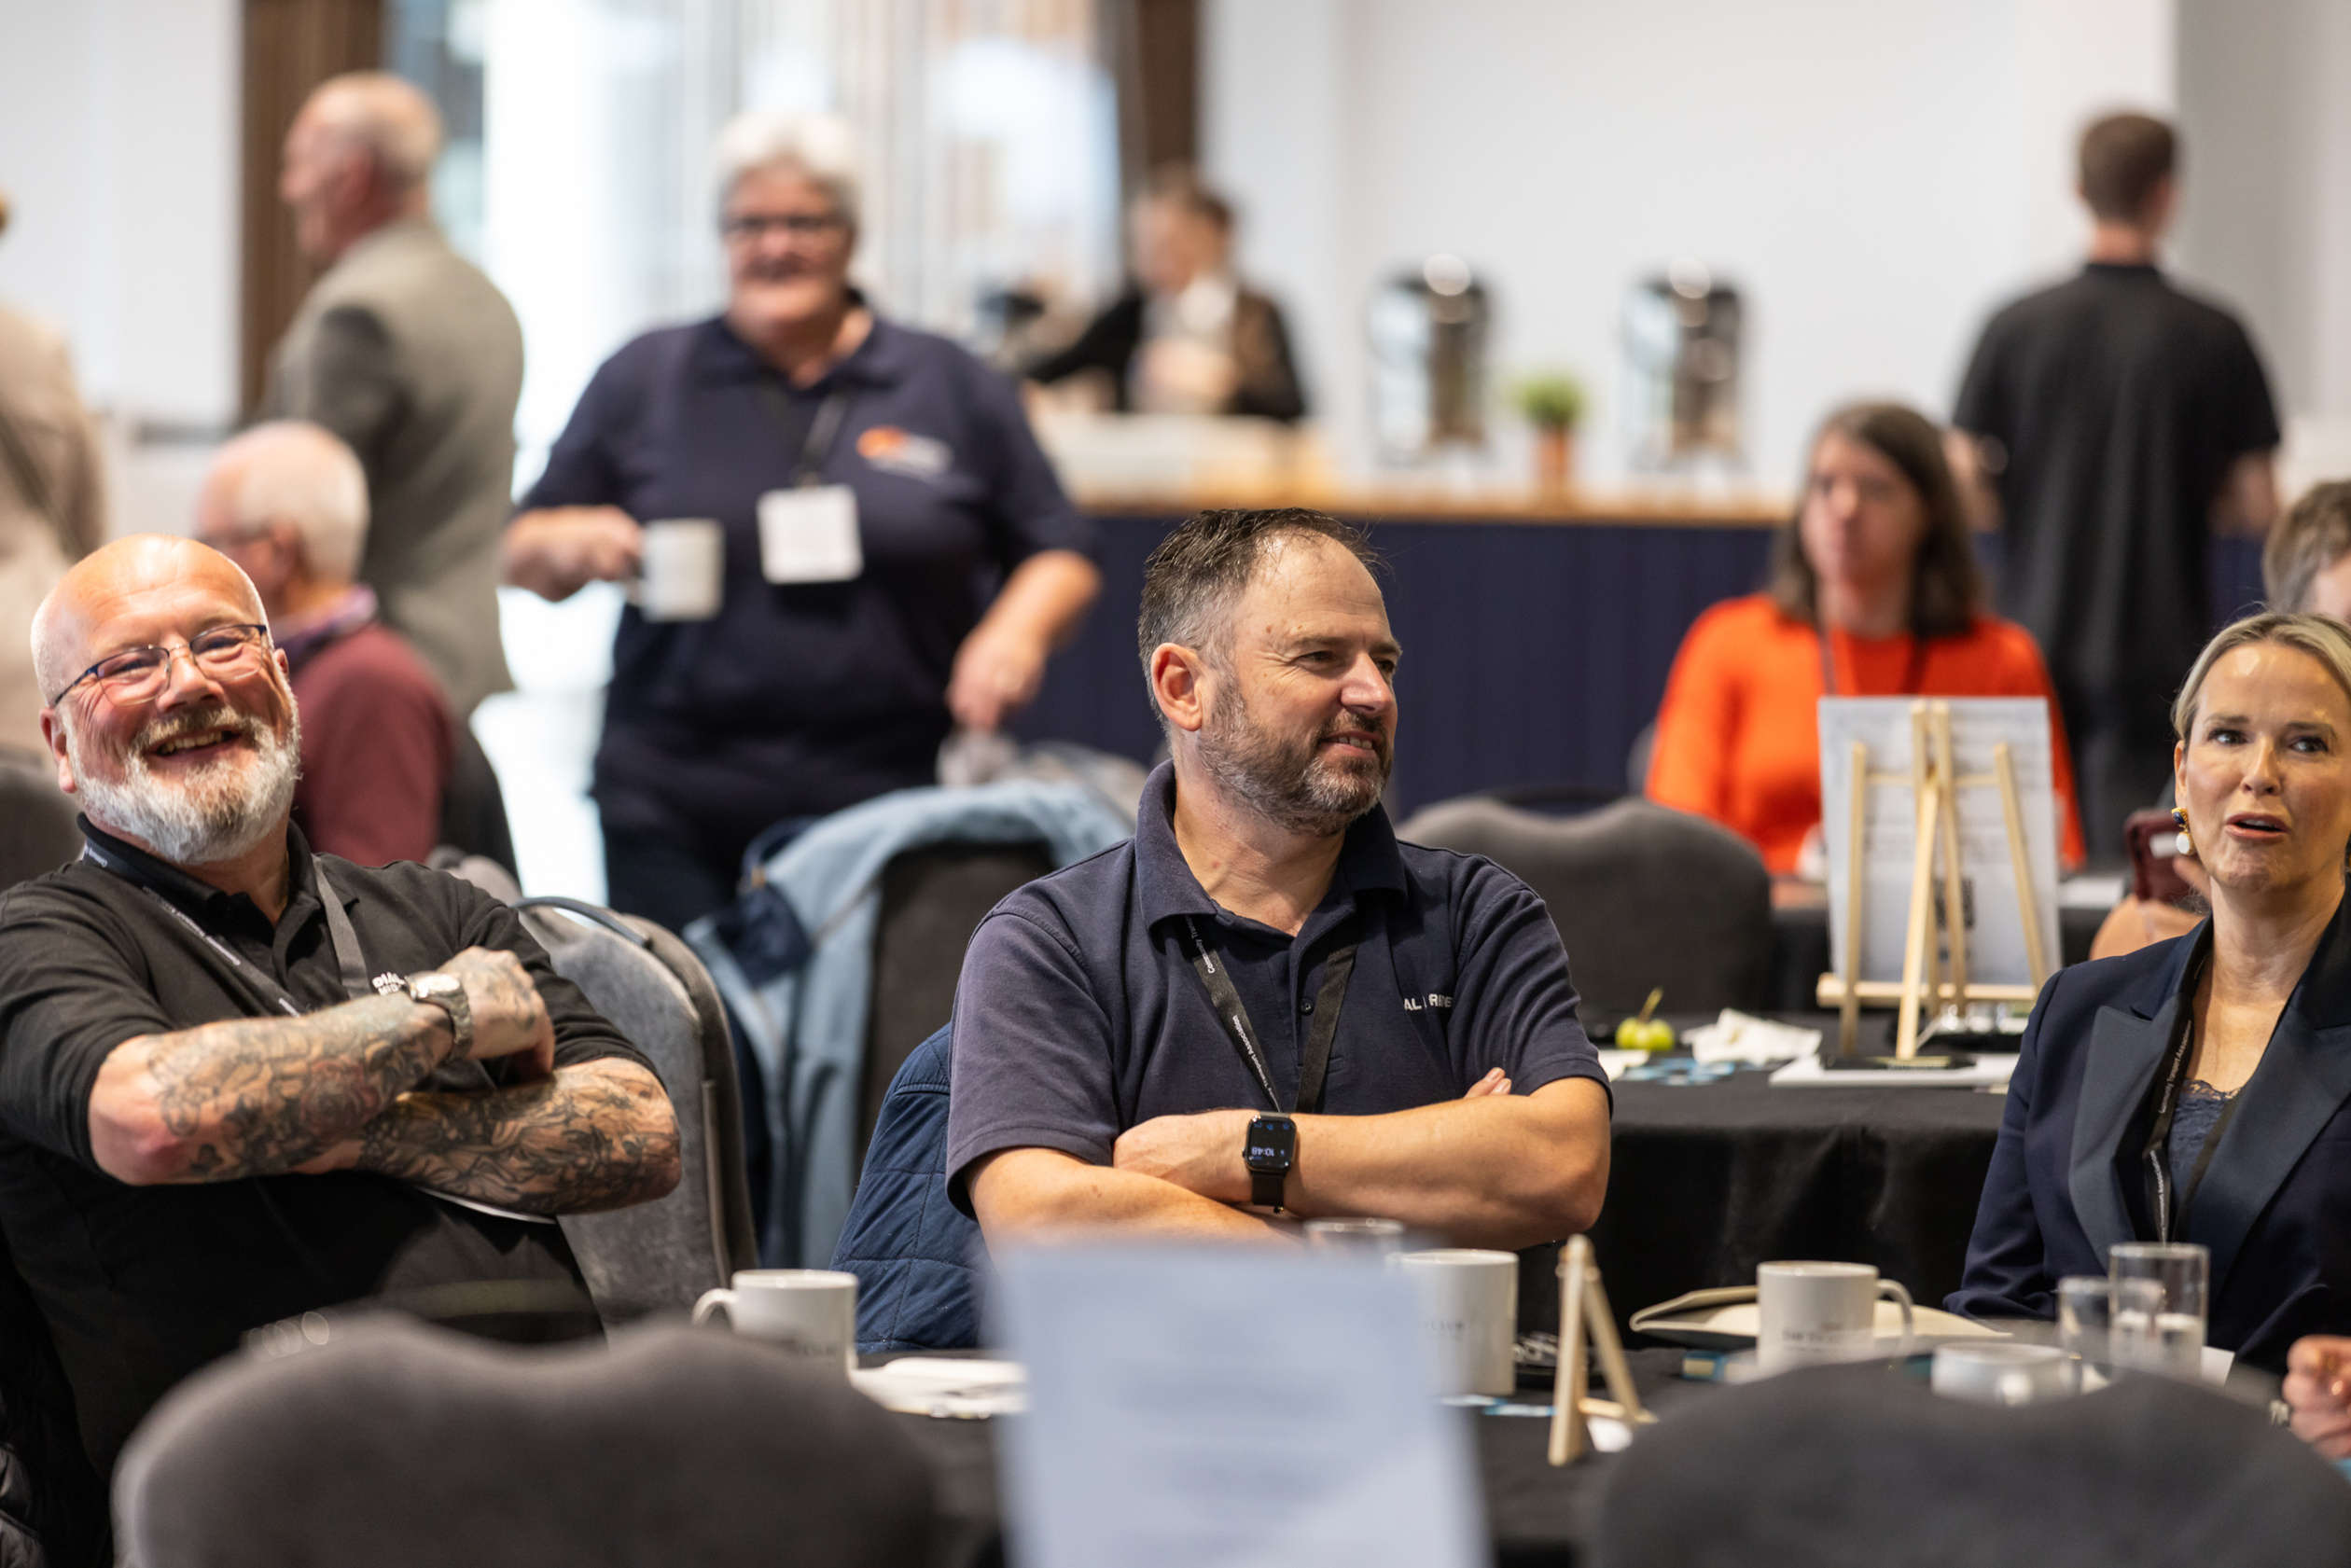



Networking Break
Please help yourself to refreshments.
#CT24

Slide 23
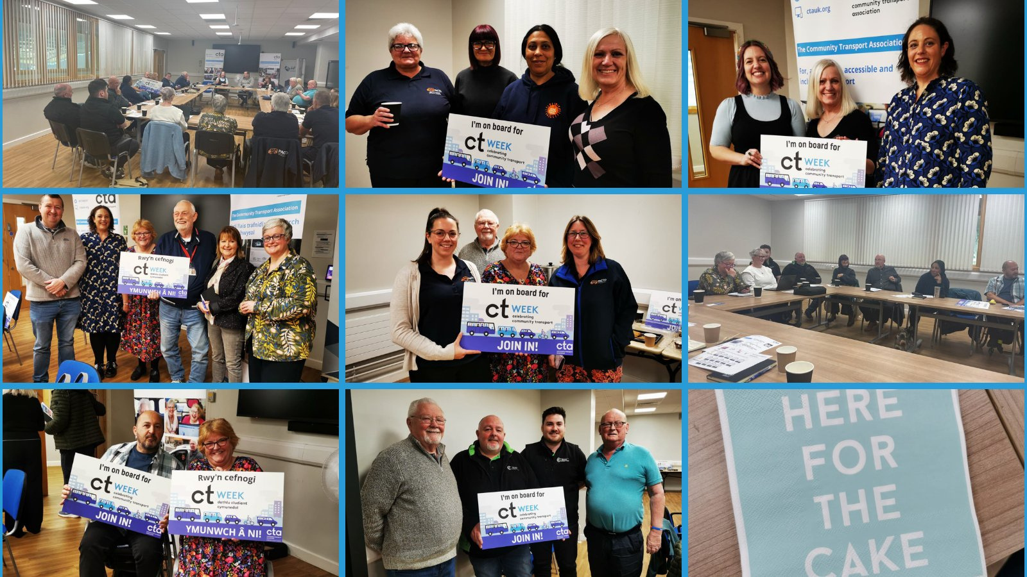
If the service was not available I would have more expensive travel and that would impact my attendance at the centers I visit
Taxis are ultra expensive. The service is amazing in so many ways - social help, door to door service. I can't say thank you enough.
Its a wonderful service you can rely on.
Wonderful volunteers.
The service is a lifesaver for us

Slide 24
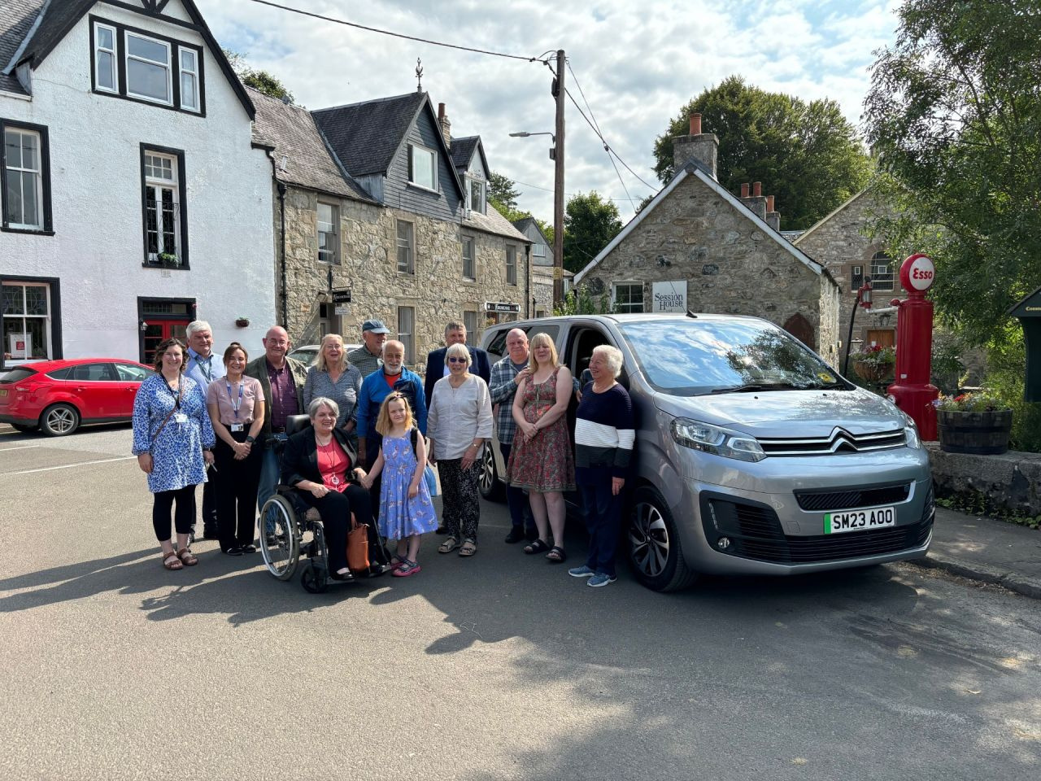
This is a lifeline for me, I live in sheltered accommodation. My family are not always available to take me to my appointments and activities. I cannot use public transport and taxis are very expensive.
Community transport can be a social activity in itself. It reduces loneliness. You get to know the drivers, see around the local area on the journey and you make friends with other passengers.
I am registered blind with mobility issues, and have no family support.
I live in supported accommodation.
I really do depend on community transport.

Slide 25
Workshop One:
Investing in Community Solutions
EMMA BINGHAM
DEVELOPMENT OFFICER, CTA
#CT24

Slide 26

Workshop One:
Delivering carbon savings through local projects that people love.
TOM BARBOUR
CHAIR, CLIMATE ACTION STRATHAVEN
#CT24

Slide 27
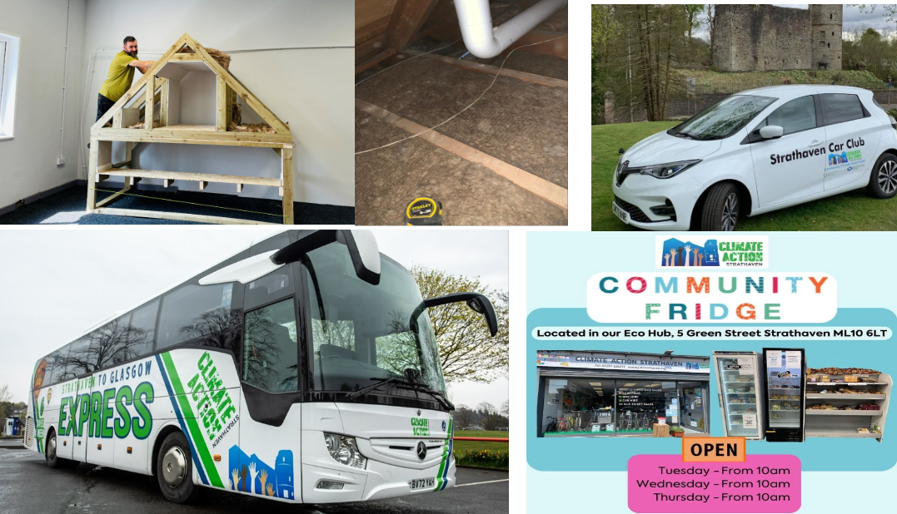

Slide 28
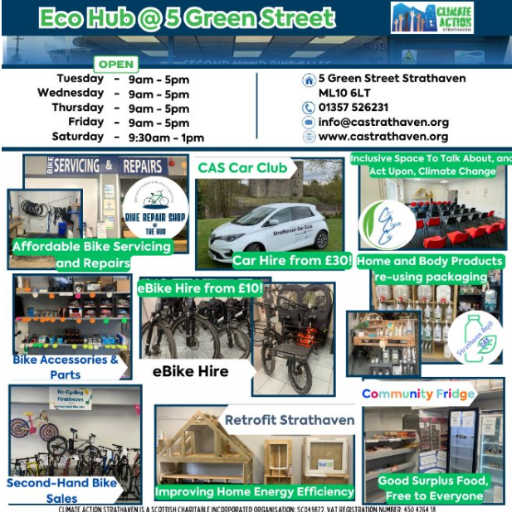

Slide 29
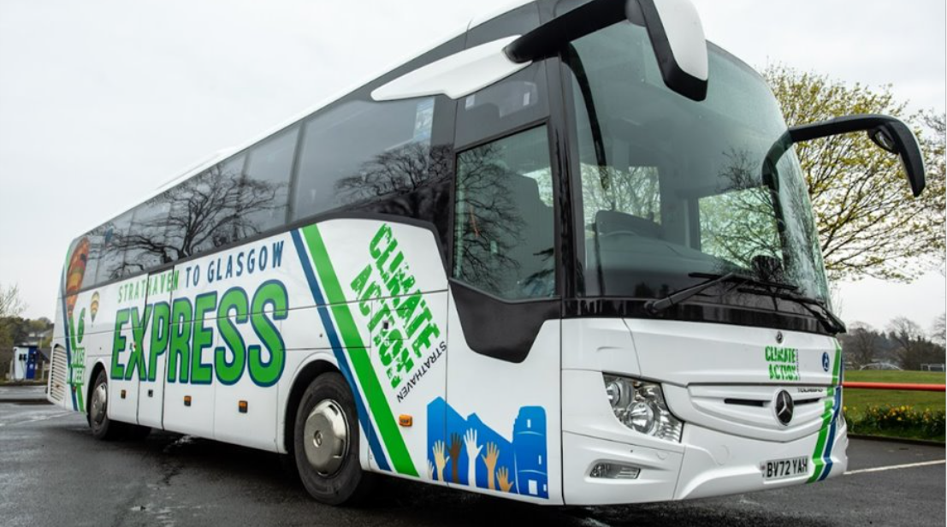

Slide 30
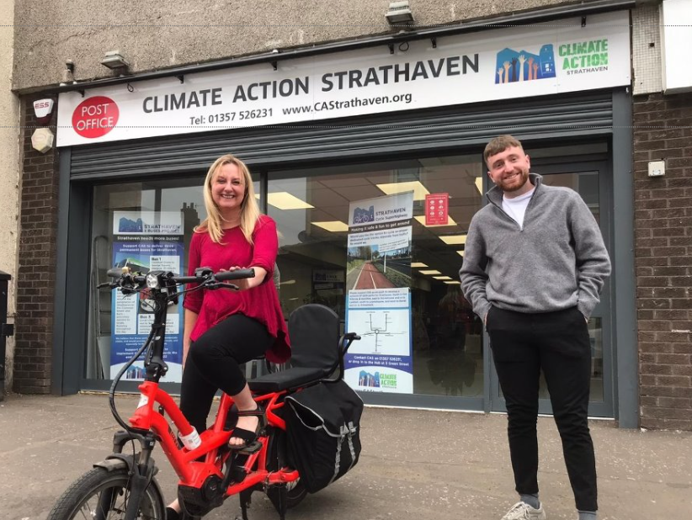

Slide 31
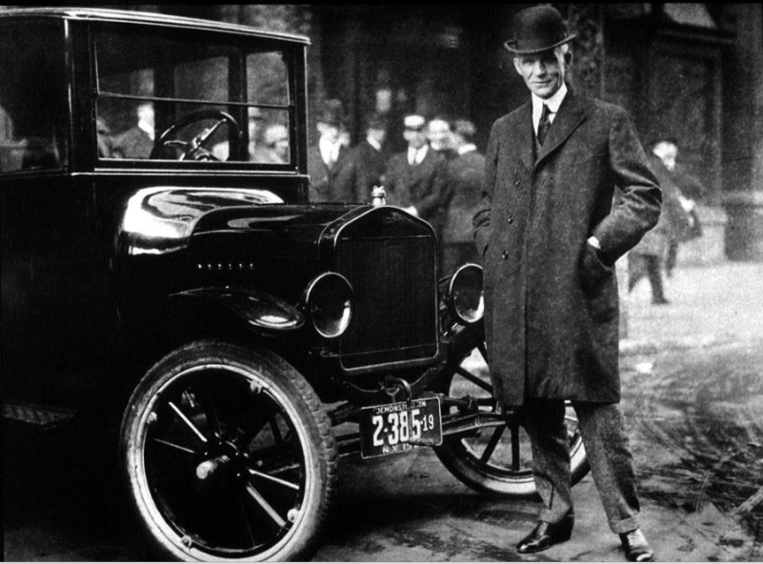

Slide 32
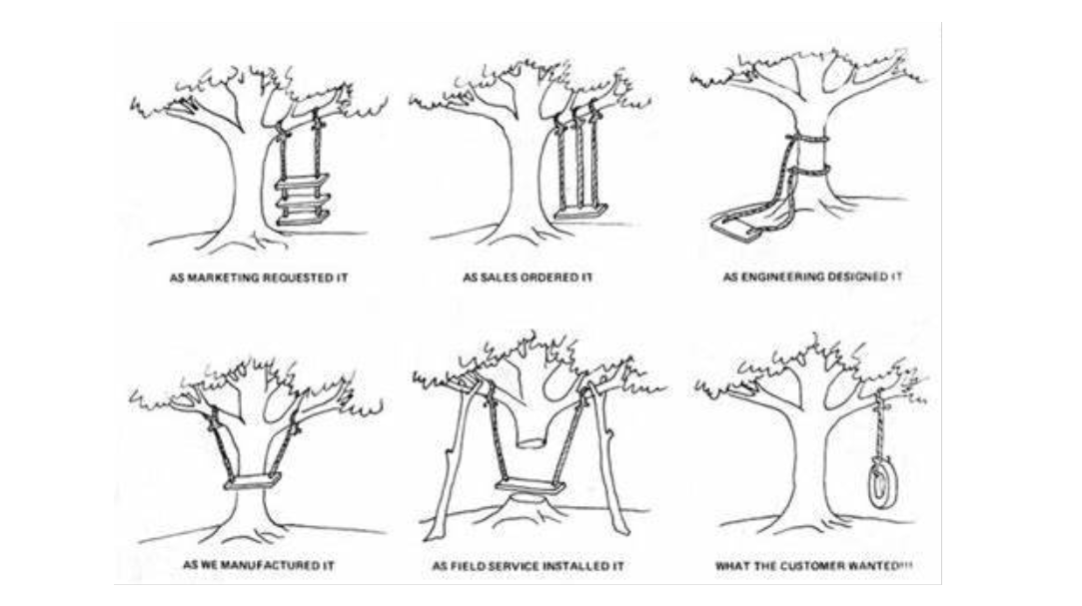

Slide 33
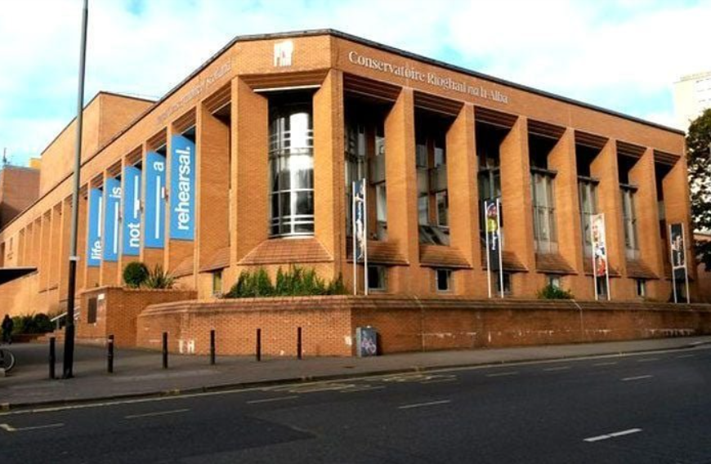

Slide 34


Slide 35
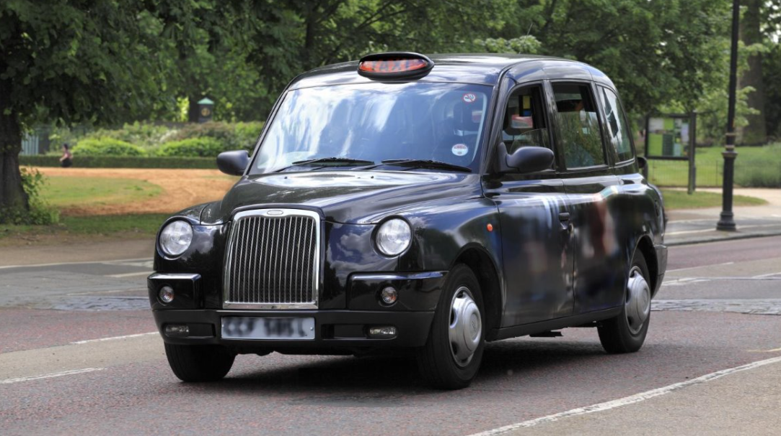

Slide 36
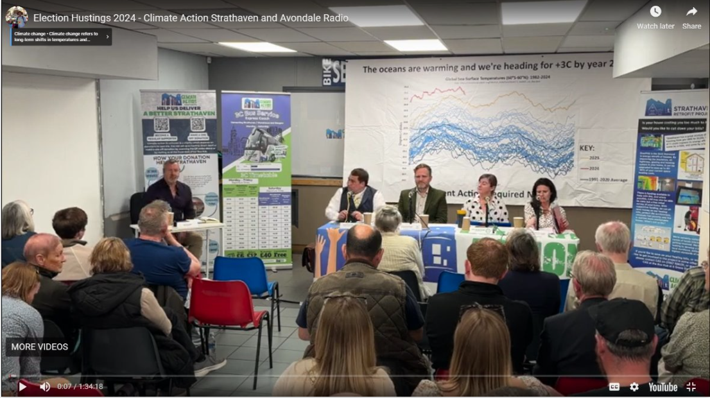

Slide 37
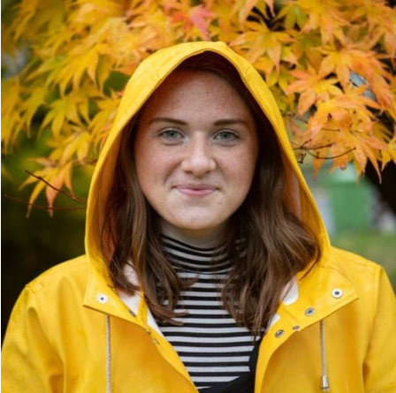

Slide 38
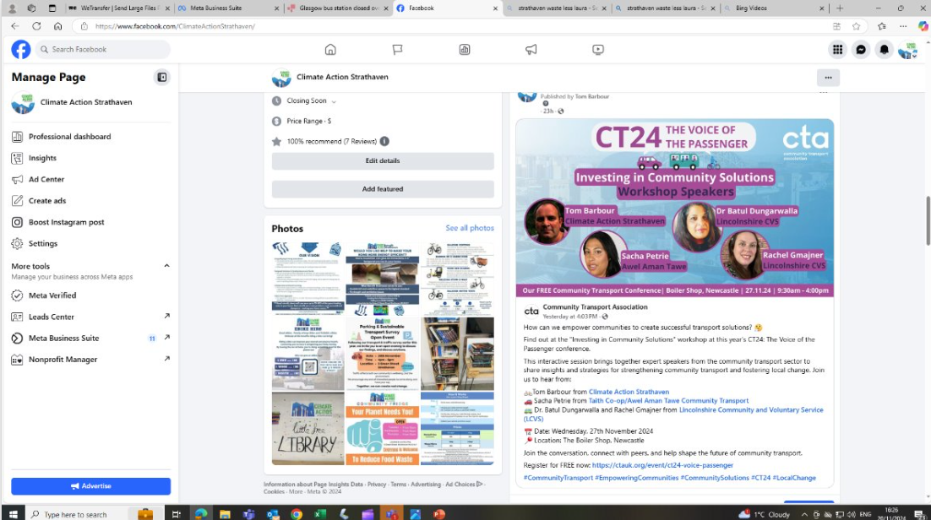

Slide 39
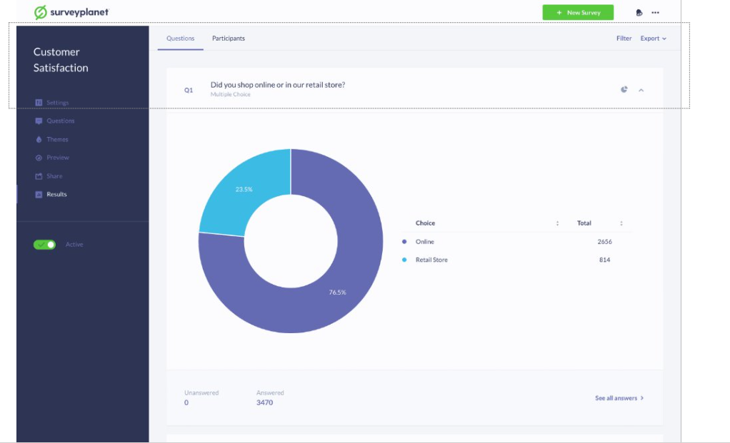

Slide 40
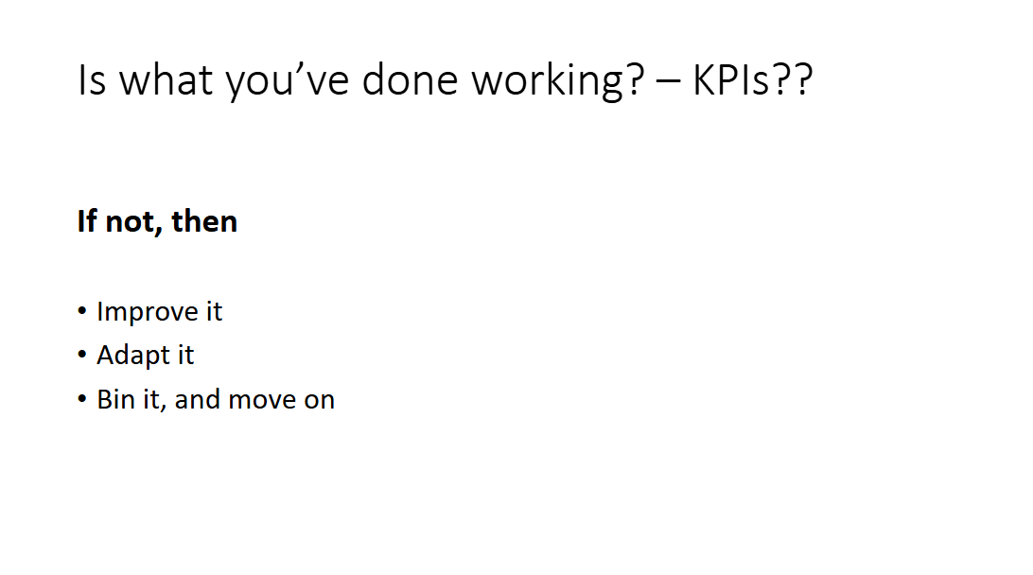

Slide 41


Slide 42
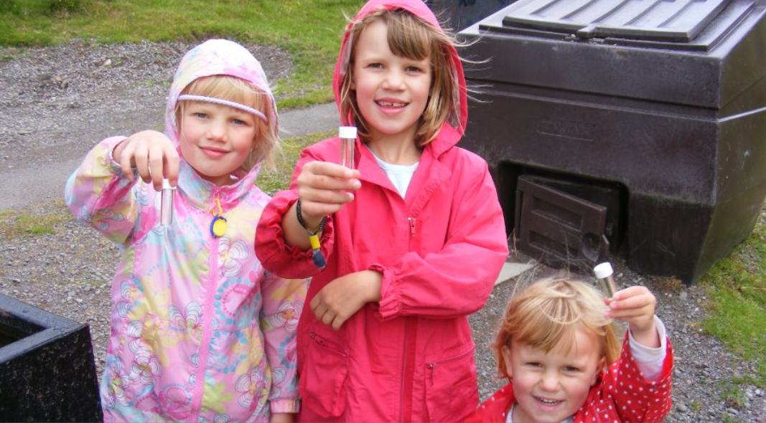

Slide 43
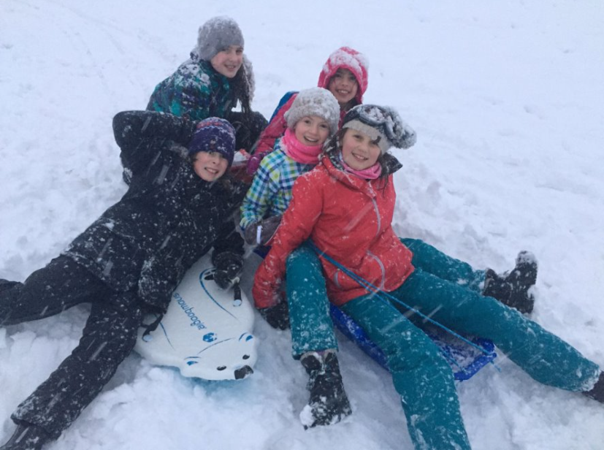

Slide 44


Slide 46

Workshop One:
Learn about successful community engagement strategies
SACHA PETRIE
COMMUNITY DEVELOPMENT OFFICER, AWEL AMAN TAWE
#CT24

Slide 47

Workshop One:
Using UKSPF funds to hire a community transport officer & its impact
DR BATUL DUNGARWALLA
RACHEL GMAJNER
LINCOLNSHIRE CVS
#CT24

Slide 48


South and East Lincolnshire Community Transport Programme
An overview by Dr Batul Dungarwalla and Rachel Gmajner

Slide 49

Geographical perspective
Tyne & Wear
Lincolnshire
  Population 1.14 million
  Land mass of 210 Sq Mi
  Predominantly Urban
  44ᵗʰ of out 48 counties based on land mass or 5ᵗʰ smallest.
  Population 775, 520
  Land mass of 2693 Sq Mi
  Predominantly Rural
  2ⁿᵈ Largest county based on land mass
13X
BIGGER

Slide 50
How did we get here?
The district councils are NOT a transport authority.
Late Spring 2022
Summer 2023
December 2023
SELCP joint scrutiny report commissioned on Public Transport
Informal discussion had about how district council economic team could support LCVS to develop CT
Bid submitted for UKSPF funding in South and East Lincolnshire
March 2023
Autumn 2023
May 2024
Recommendation from the report to ‘ Support rural mobility through community-led solutions’
Exploration of scope of proposed project and bid drafted
Project Commenced
A CVS is an infrastructure organisation for the voluntary and community sector, we bring together organisations for a cross-sector collaboration to strengthen communities.

Slide 51

Desired Outcomes
  Focused outreach and development work
  To understand transport related social exclusion
  Identifying all CT schemes across the funded area and their scope of service
  Changing the perception of community transport
  Leading the development of a Lincolnshire community transport consortium
  Supporting the collection of data and insight
Key Performance Indicators:
  Increase in journeys and journey types
  Completion of public perception surveys
  Increase in volunteers within CT schemes

Slide 52
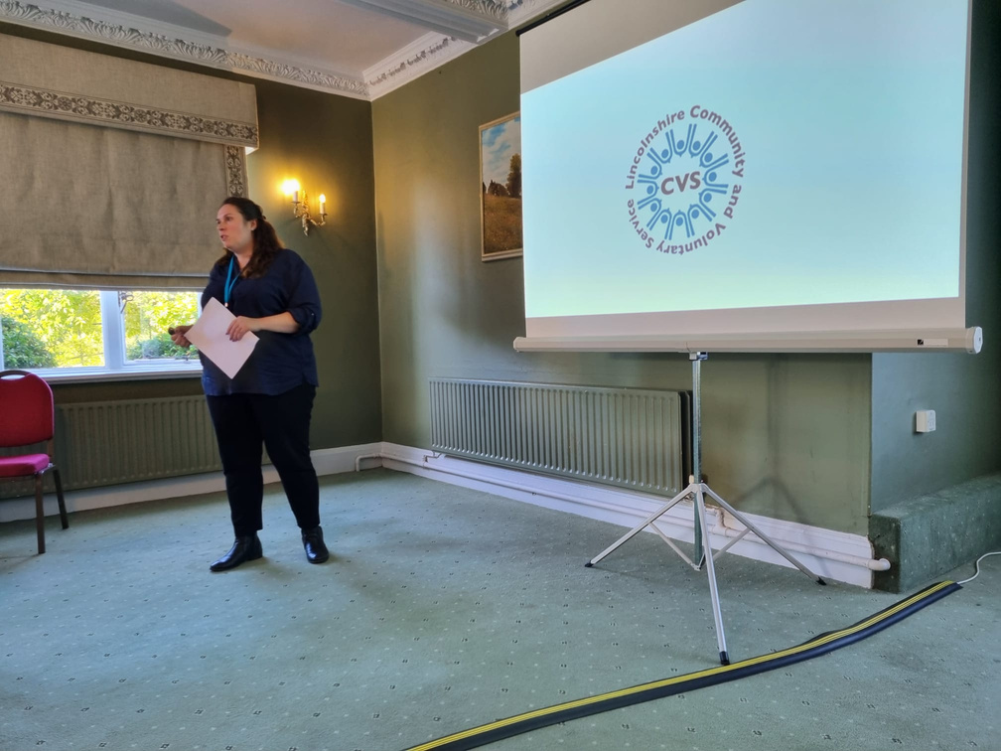
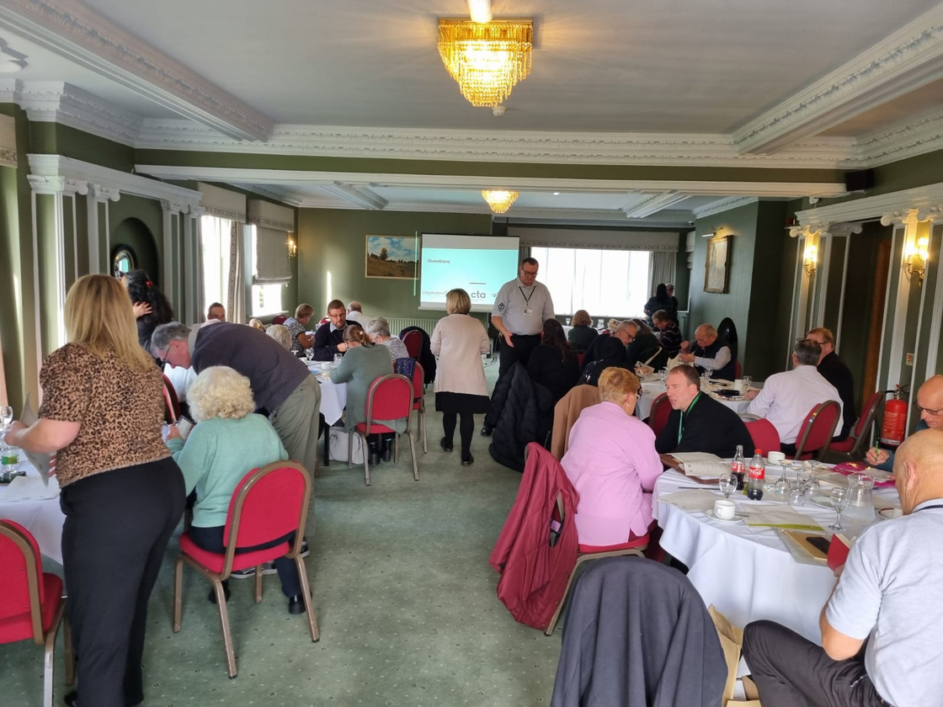
What have we done so far?
Networking
  Audit of schemes - 23/24 data collected
6 schemes engaged
187 Volunteers
17841
Journeys
570,284 Miles
  Gap Analysis
  Information gathered suggests that at least 90% of these journeys were medically related.
Social journeys for disabled, older and vulnerable people are most lacking despite high demand

Slide 53
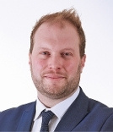
“
Matthew Hogan – Assistant Director for Strategic Growth and Development for South and East Lincolnshire Partnership
One of our key priorities is to support our market towns to become more resilient to help address climate change and to help our communities access services and employment and generally feel more connected, which is why the work that LCVS are doing to support the expansion of community transport in our area and help develop new provision is such an important part of our overall strategy to help support our rural communities

Slide 54
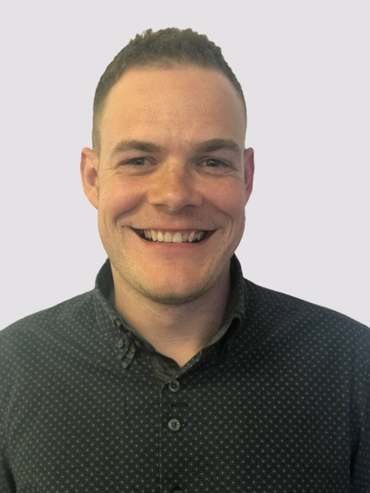
“
Ben Rollett – CEO, Lincolnshire Community and Voluntary Partnership
A key priority of Lincolnshire Community and Voluntary Partnership is to support local people to access support and services within their community, this fits seamlessly into the aims of the UKSPF funded programme.
We are proud to support our community transport schemes across the County to help them develop and thrive to meet the needs of our residents.
Our Vision for Volunteering in Lincolnshire aims to create a culture where volunteering is part of everyone's life and volunteer roles are given the recognition they deserve.

Slide 55

Our Hopes for the Future
Lincolnshire CT Consortium
Additional funding via Transport Authority
With changes in local authority responsibilities due to devolution and budget reviews there is the potential for Lincolnshire County Council to passport funding into LCVP for VCS’s development.
With LCVS providing the secretariat to support opportunities for shared resources, funding applications and networking.
Scheme audit of wider Lincolnshire
To further establish services available and any gaps in provision county wide.
To leave a legacy of positive growth and development that can be nurtured and sowed time and again wherever needed.
Development of existing schemes
To ensure sustainability, best practice to include governing policies and volunteer recruitment and retainment.

Slide 56
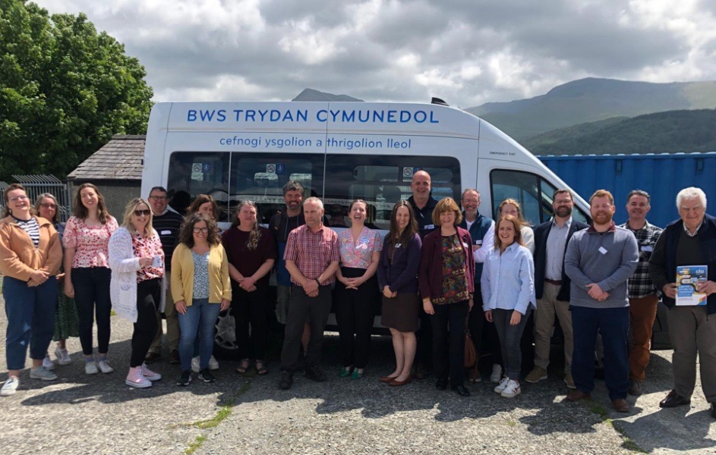
Lunch
Please help yourself to refreshments.
#CT24

Slide 57
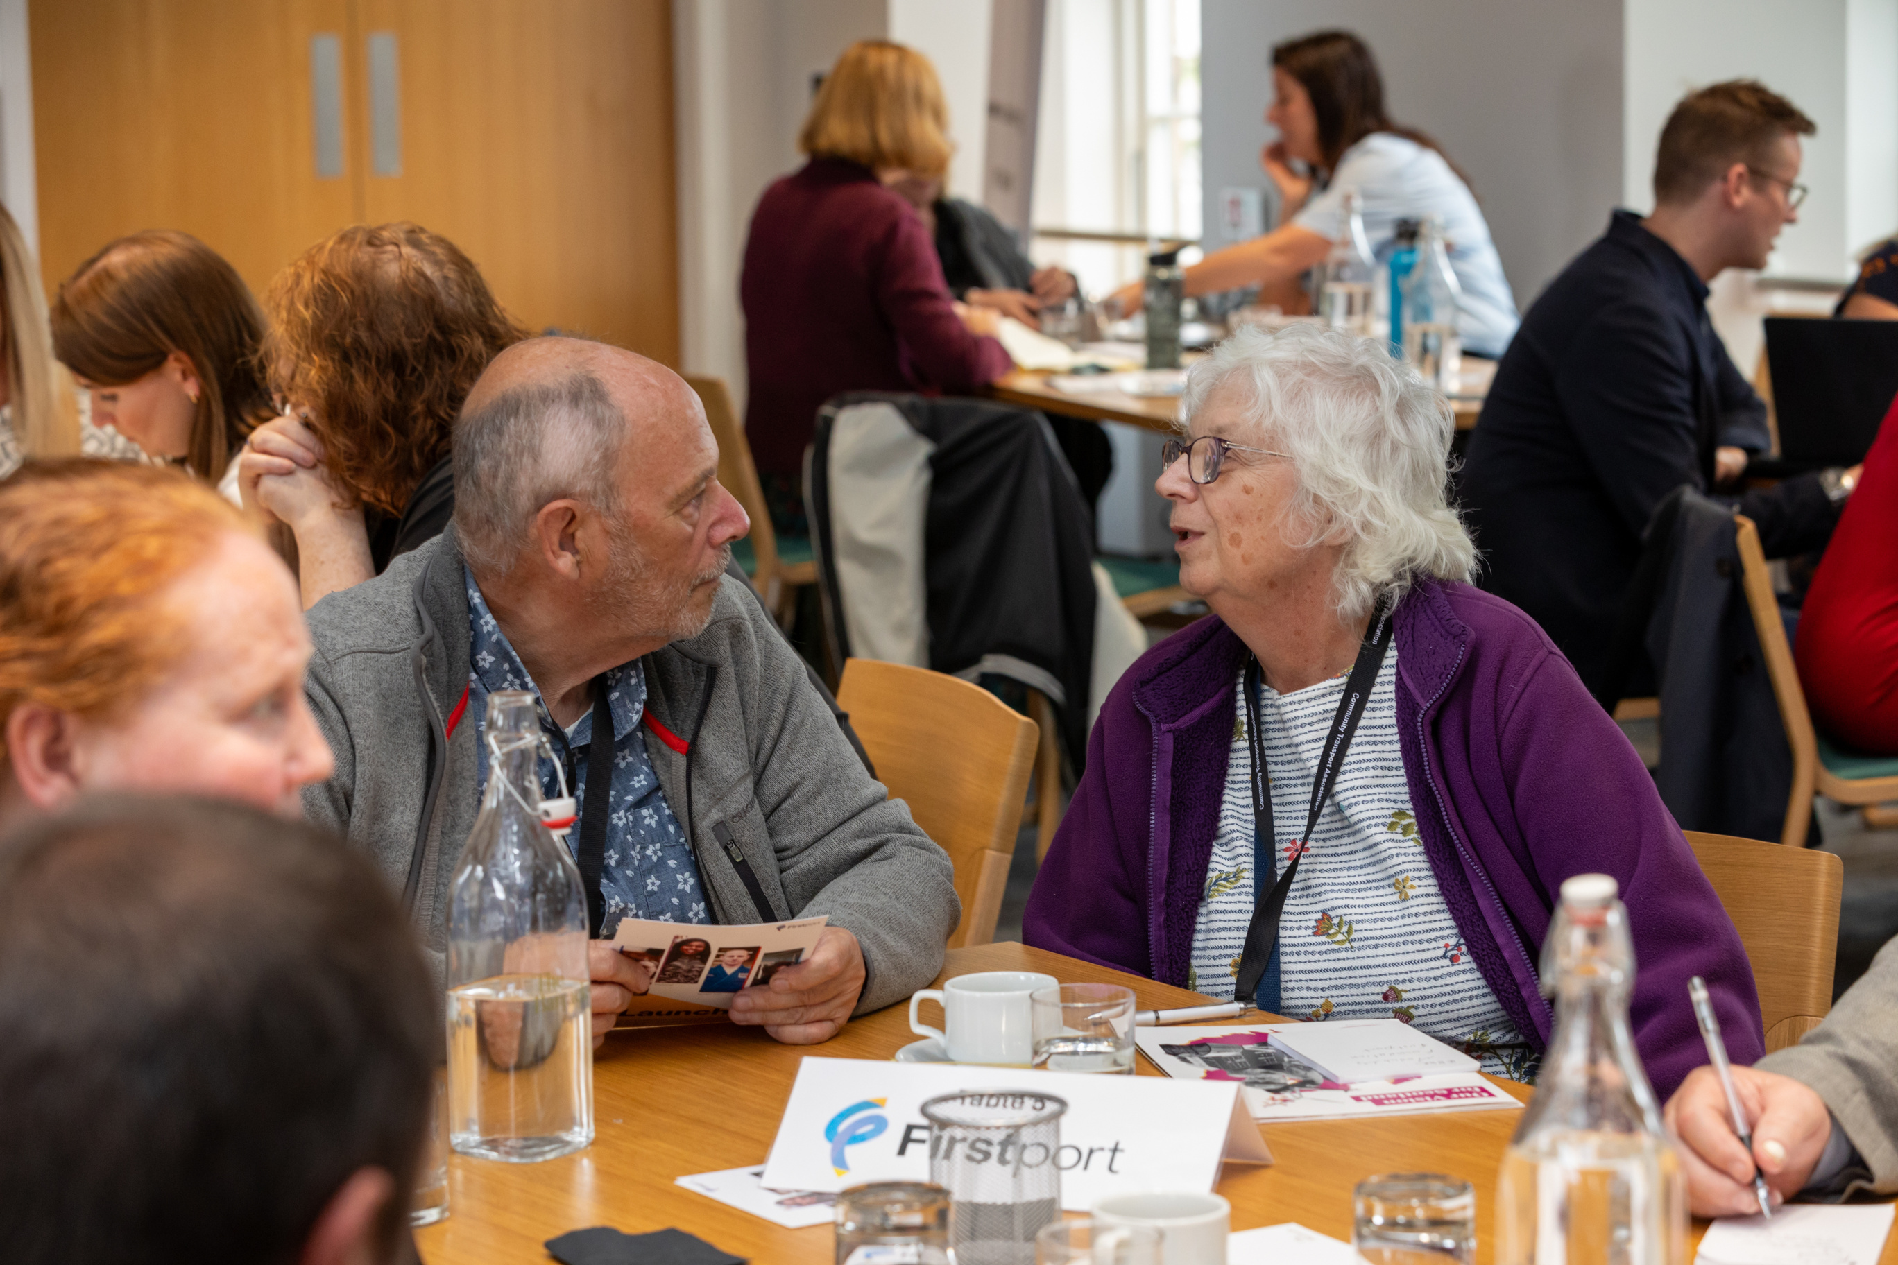
Community Transport provides me with a safe means of travel. I won't be forgotten and I won't be left behind at my pick-up points as staff and drivers are aware of my health issues as I often suffer seizures, my safety is at risk using other means of transport. If I am not where I should be drivers know something is wrong.
When I ring the office, they are so charming, and always help me. I really need this wonderful service, I look forward to every time I use it.
I live on my own and am wheelchair bound. This is a vital service for me for attending hospital appointments. The driver supports me to get to the doctor, it is my lifeline.

Slide 58
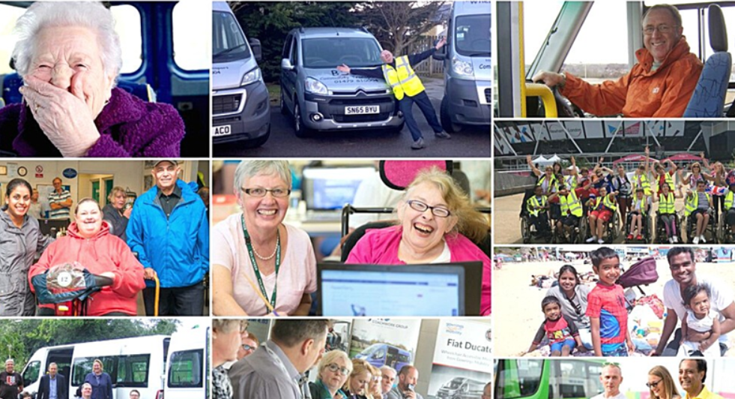
I would rely on a neighbour if there was no bus, or would have to book a delivery. We love a gossip and we find out information we might not know otherwise.
I could not live without the scheme. I have no family and it's my only means of getting out.
Without Community Transport I would not be able to attend the day centre, which would lead to increased loneliness and isolation. The day centre was recommended by the consultant at the hospital

Slide 59


Slide 60
Community Transport Association
Annual General Meeting
27 November 2024
ALAN JONES
CHAIR
#CT24

Slide 61
Agenda
1.
Welcome and introductions
2. Apologies for absence
3. Ordinary Resolution 1 – to approve the minutes of the 2023 Annual General Meeting
4. Trustees’ Annual Report and Financial Statements 2023-24
5. Ordinary Resolution 2 – to approve the Trustees’ Report & Financial Statements
6. Ordinary Resolution 3 – to approve the appointment & remuneration of the auditors
7. Special Resolutions 1 to 4 – to make amendments to the Constitution
8. Confirmation of the CTA’s Board of Trustees from 27 November 2024
9. Any Other Business
#CT24

Slide 62
Ordinary Resolution 1
  Approval of the minutes of the Annual General Meeting held on Thursday 23 November 2023
#CT24

Slide 63
Trustees Annual Report &
Financial statement 2023-24
  Reflections
#CT24

Slide 64
Annual General Meeting
27 November 2024
PHIL BENTON
FINANCE DIRECTOR, CTA
#CT24

Slide 65
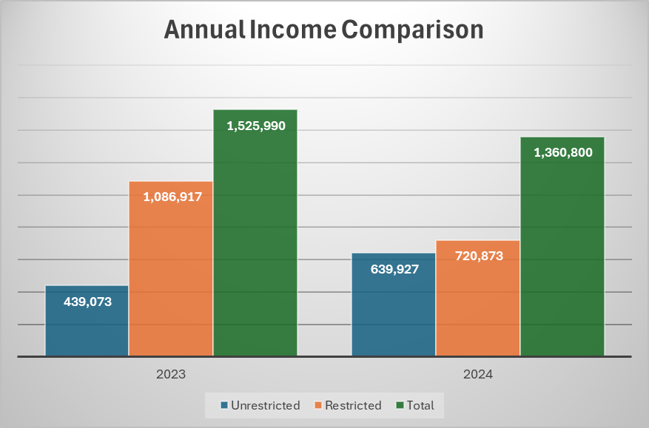
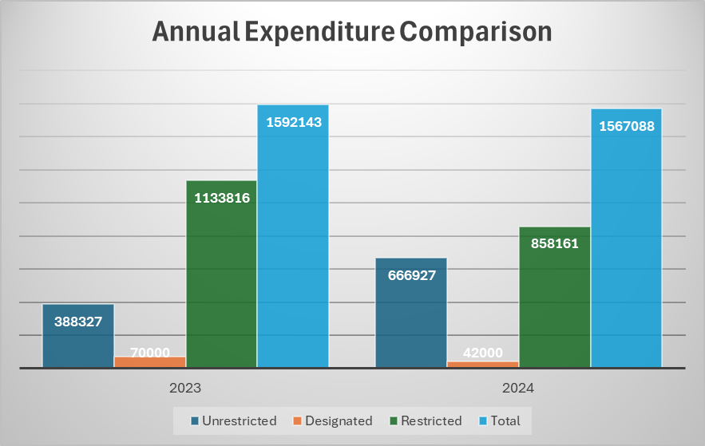
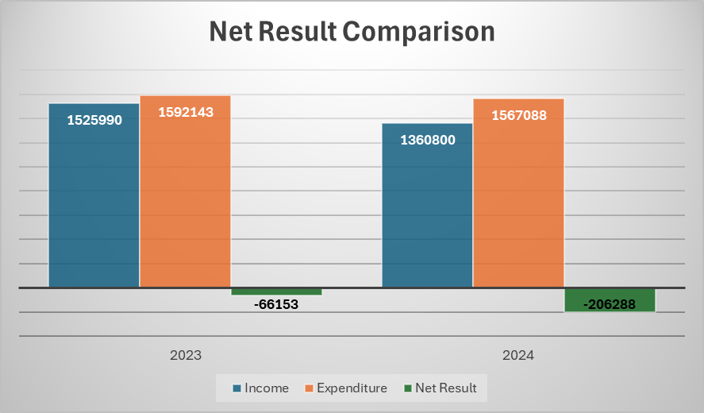
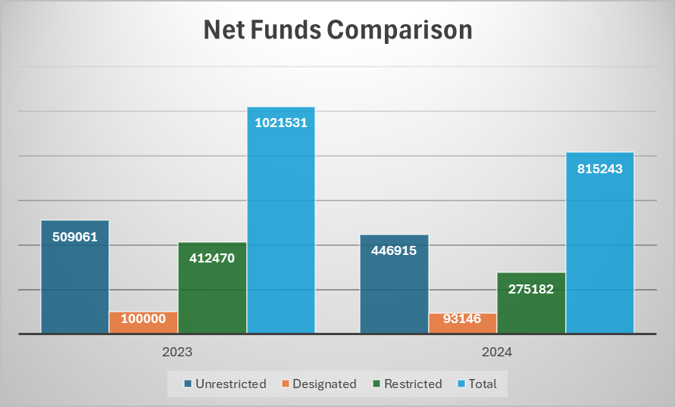

Slide 66
Ordinary Resolution 2
  Approval of the Trustees Annual Report and Accounts for the year ended 31 March 2024
#CT24

Slide 67
Ordinary Resolution 3
  Approval of the appointment of Dains Audit Limited to be the CTA’s auditors for the 2024/25 financial year, and to delegate authority to the Board to set their remuneration
#CT24

Slide 68
Special Resolutions
You can find the formal wording of all special resolutions in the AGM notice,
Follow the QR code on your name badge.
#CT24

Slide 69
Special Resolution 1 – amendment of trustee numbers
Formal wording contained in the AGM notice.
Summary:
  Increase member trustees from 6 to 7
  Increase co-opted trustees from 5 to 6
  Require that from the total number of trustees, there must be at least one located in each of Scotland, Wales and Northern Ireland
#CT24

Slide 70
Special Resolution 2 – amendment to rules on trustee removal
Formal wording contained in the AGM notice
Summary:
  Currently a trustee can be removed if they miss two consecutive meetings without apology
  Amending the provision so they can be removed if they miss any two meetings out of the annual cycle of four without apologies
#CT24

Slide 71
Special Resolution 3 – amendment to procedure for appointing Board officers
Formal wording contained in the AGM notice
Summary:
  Clarifying that the posts of Chair, Vice Chair and Treasurer are appointed by the Board from within its membership
  Terms of office to last 3 years, renewable for a further 3, subject to the postholder’s continued membership of the Board
#CT24

Slide 72
Special Resolution 4 – amendment to rules on who can attend Board
Formal wording contained in the AGM notice
Summary:
  Clarify that as well as the Chief Executive, other nominated Directors can attend Board
  Create a provision for the Board to appoint advisors and/or observers for a specific period of time, or for a specific strategic need
  Anyone appointed in that capacity will not have voting rights, and will not carry the responsibilities of a trustee
#CT24

Slide 73
8. Trustee Board Membership
(From 27 November 2024)
Member Trustees
  Sue Leighton – Vice Chair
  Susan Dever, Coalfield Community Transport
  Stephen Craker, Community 1st
  Andrew Grieve, CT4N
Co-opted Trustees
  Alan Jones - Chair
  Oxana Grishina
  Martin Heffer
  Andrew Benfield
  Scott Pearson
As a result of special resolution 1, we now need to recruit:, 3 member trustees and 1 co-opted trustee.
#CT24

Slide 74
9. Any Other Business
#CT24

Slide 75
Member’s Lightning Talks
GEMMA LELLIOT
WALES DIRECTOR, CTA
#CT24

Slide 76

Community transport saved my life, now I’m helping communities.
LESLEY-ANN MILLAR
MANAGER
SOUTH ANTRIM COMMUNITY TRANSPORT
#CT24

Slide 77

Winning Scotland’s Best Bus Service Award!
DREW SMART
CHAIRPERSON
GLENFARG COMMUNITY TRANSPORT
#CT24

Slide 78




GLENFARG
CT24 The Voice of The Passenger
Winning the Best Bus Service Award at
Scottish Transport Awards2024
Drew Smart, Chair
Glenfarg Community Transport Group

Slide 79
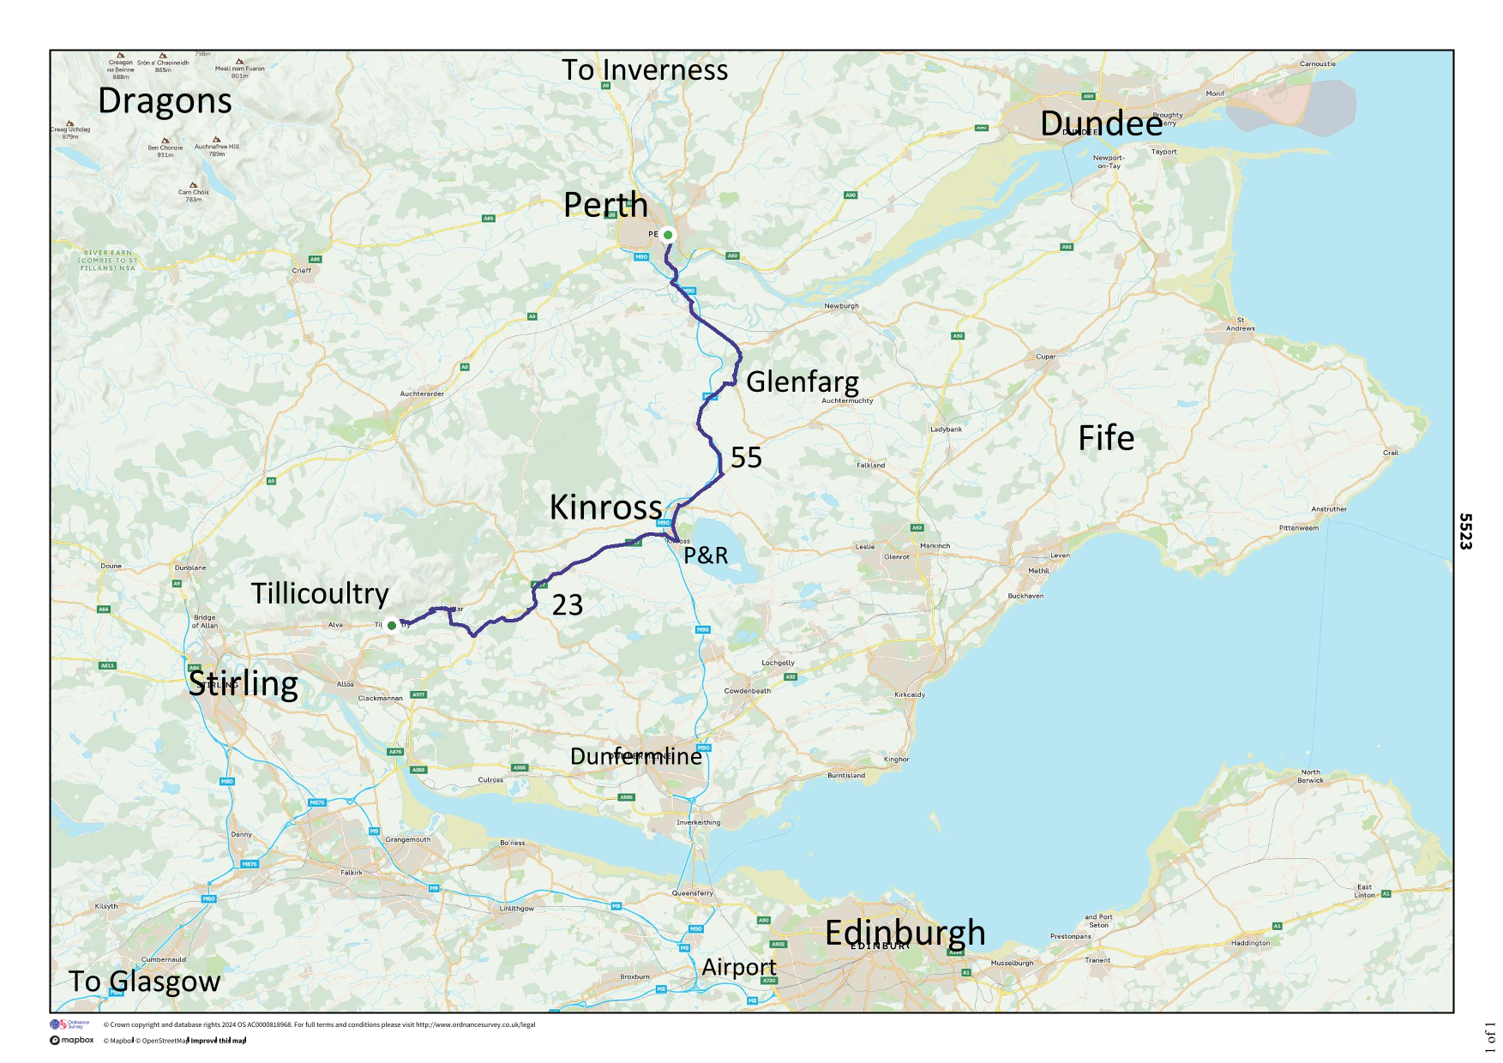
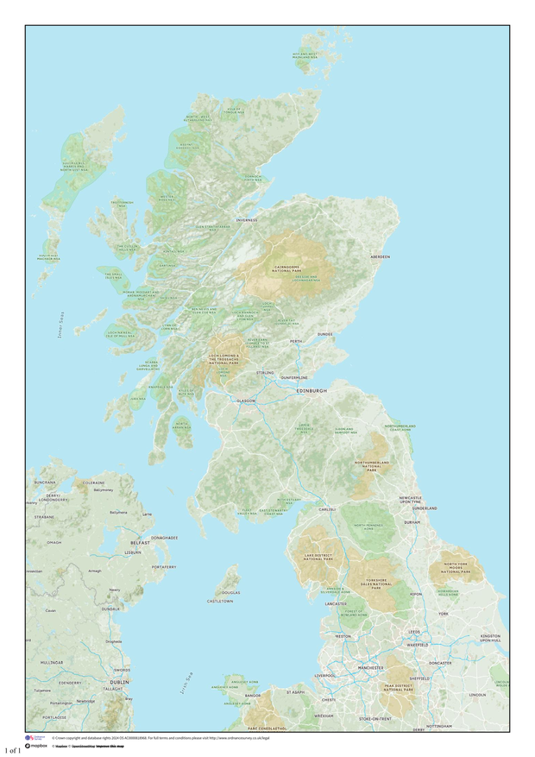
Where we are:

Slide 80
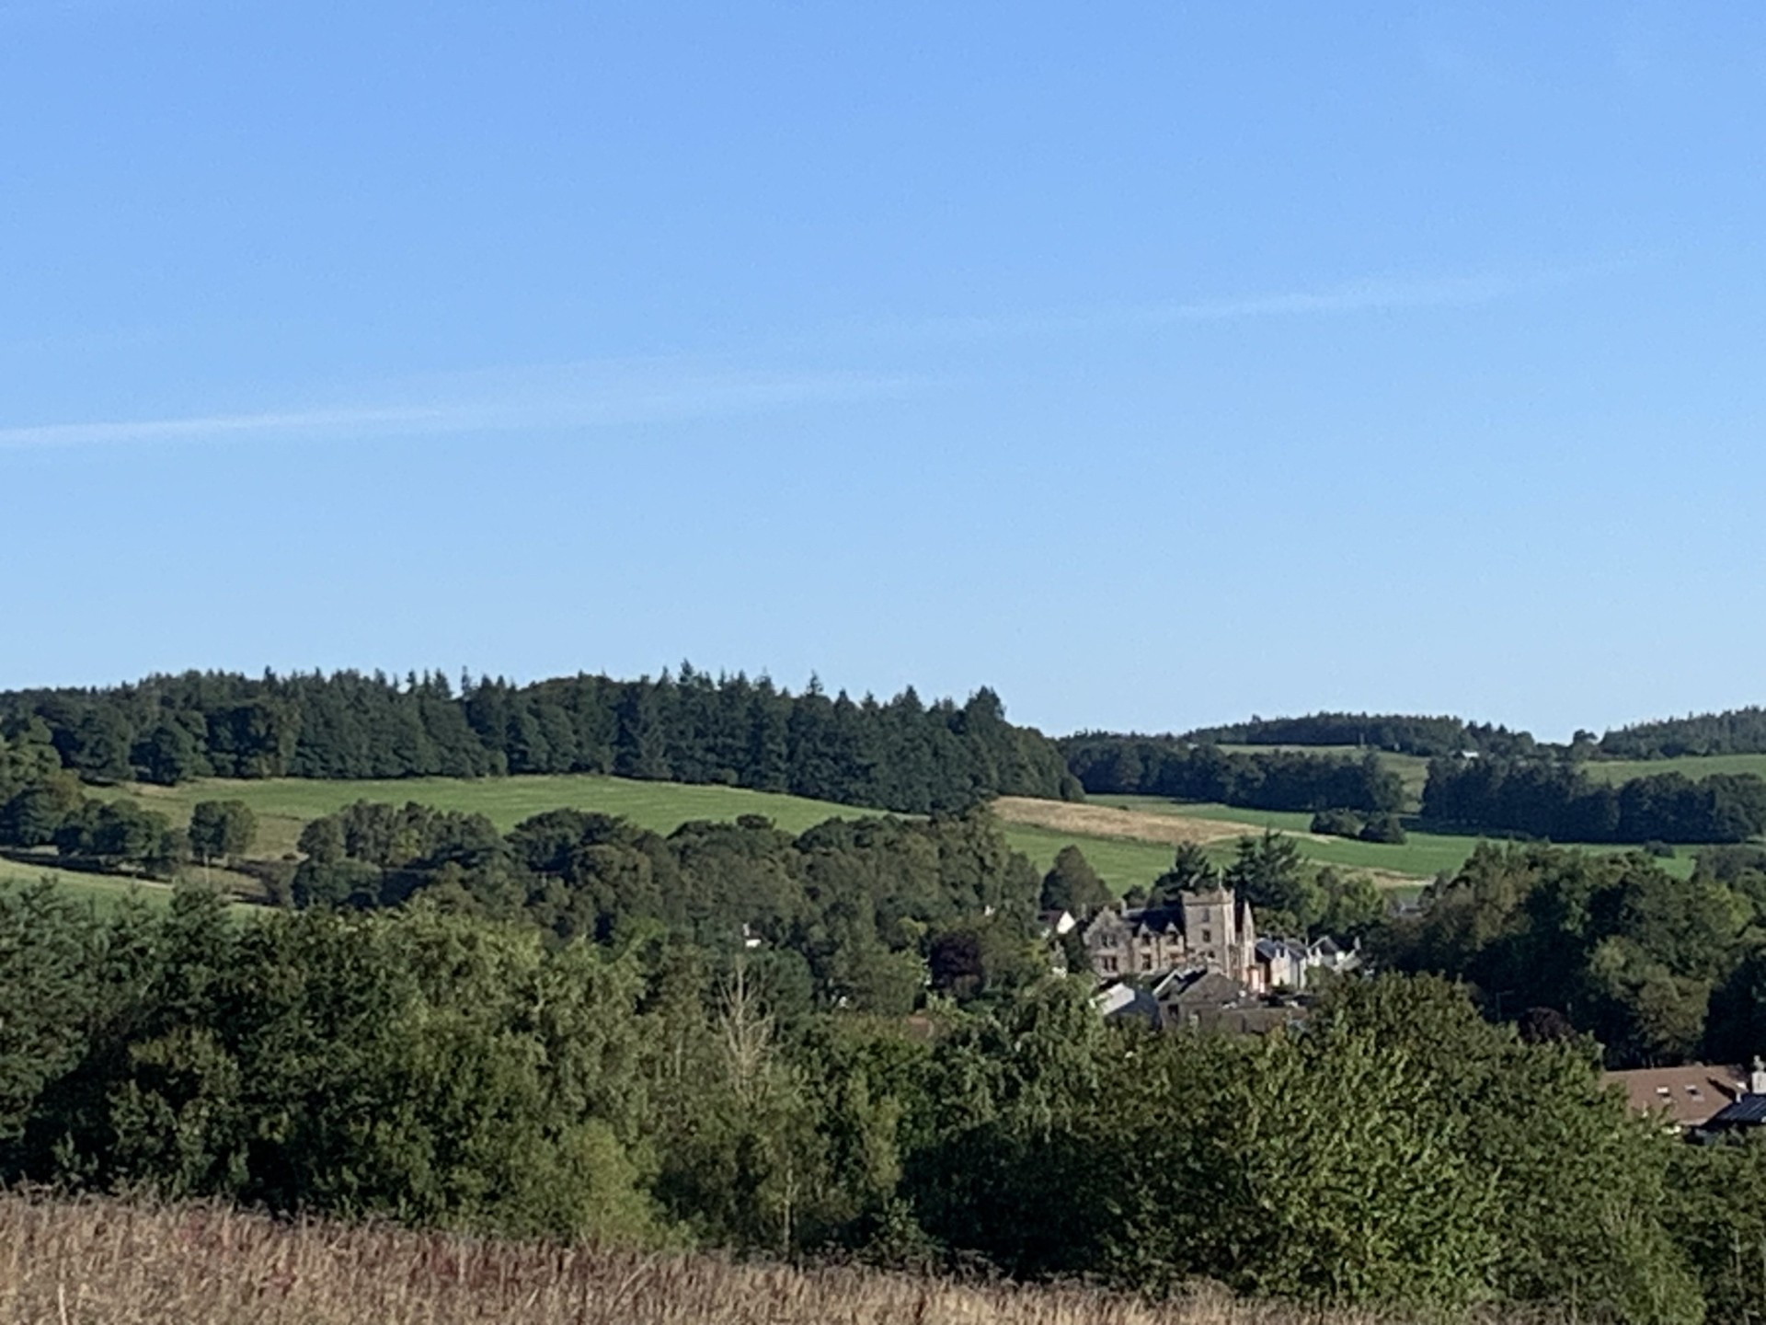
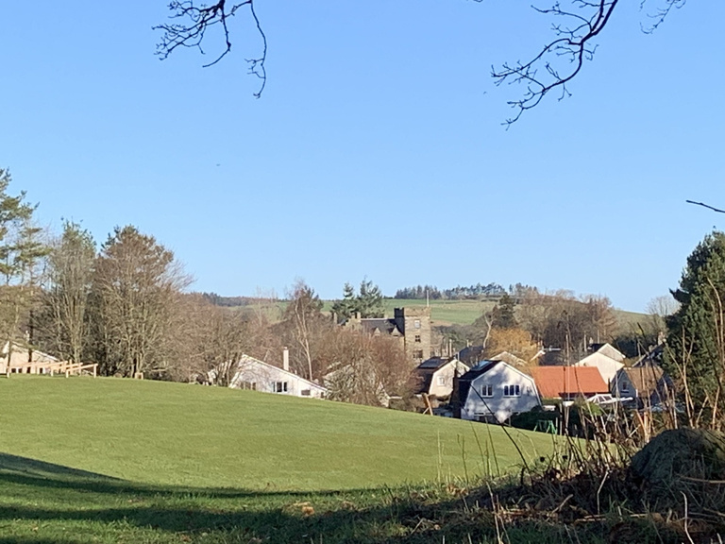

Slide 81
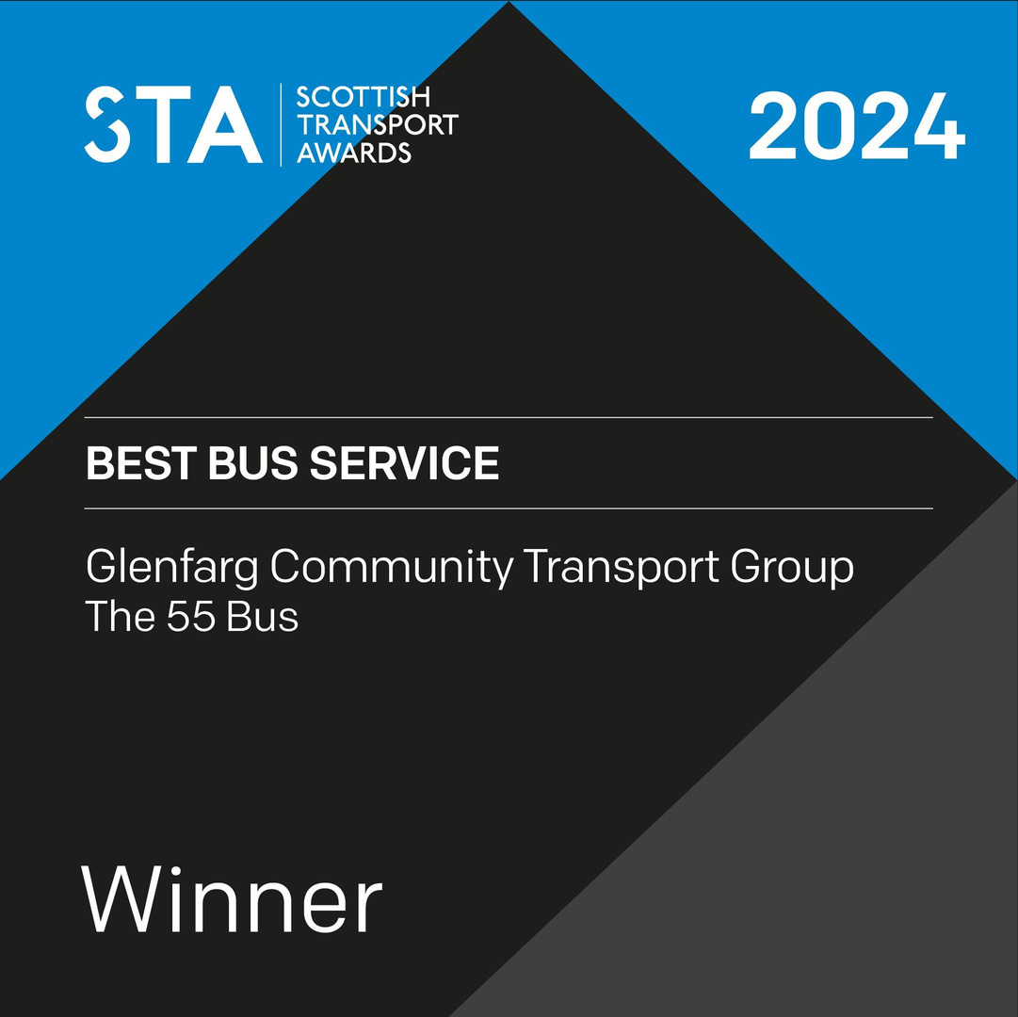
Scottish Transport Awards 2024
Best Bus Service Category
Success in this category should demonstrate how changes to bus services and facilities have brought about improvements by:
  increasing passenger numbers;
  demonstrating modal shift;
  improving customer satisfaction;
  or improving reliability

Slide 82
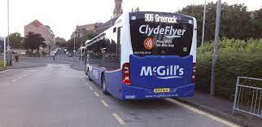
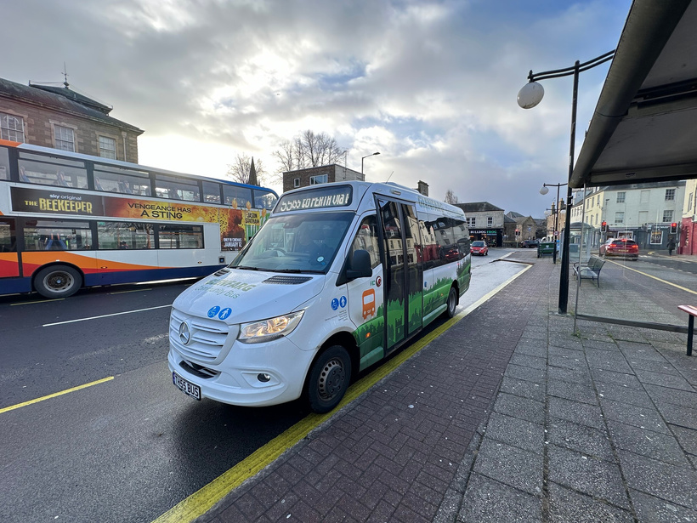
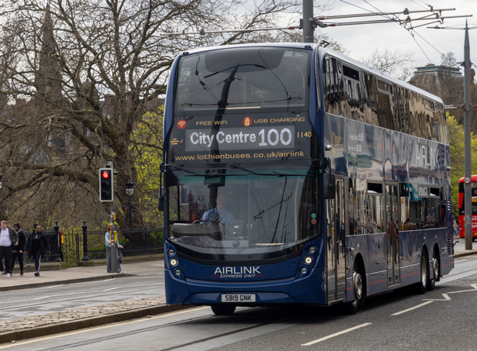
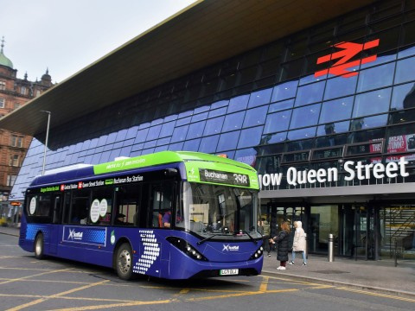
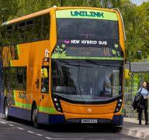

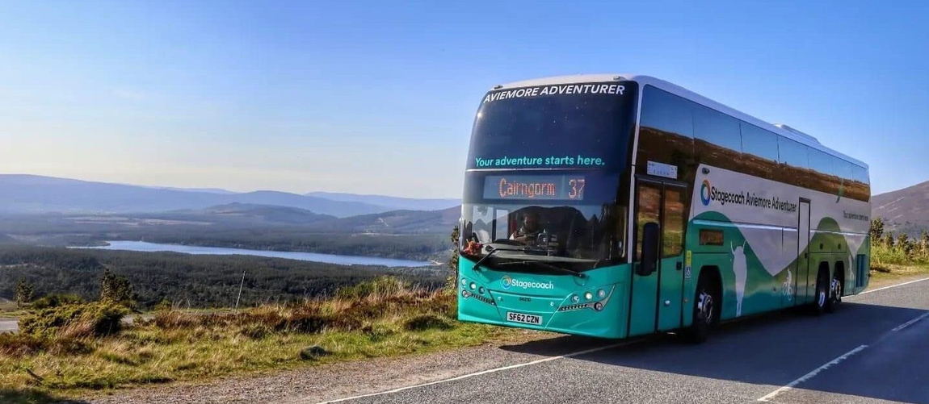
Scottish Transport Awards - Best Bus Service
June 2024 - Short list…
Glenfarg Community Transport – The 55 Bus
Lothian Buses – Airlink Service 100
McGills – Clydeflyer
McGills - Unilink
Scotrail – Glasgow Station Bus Link
Stagecoach – Fife to Edinburgh Airport Jet747
Citylink – Service 902 Glasgow to Edinburgh Airport
Stagecoach – Aviemore Adventurer
And the winner is…..

Slide 83
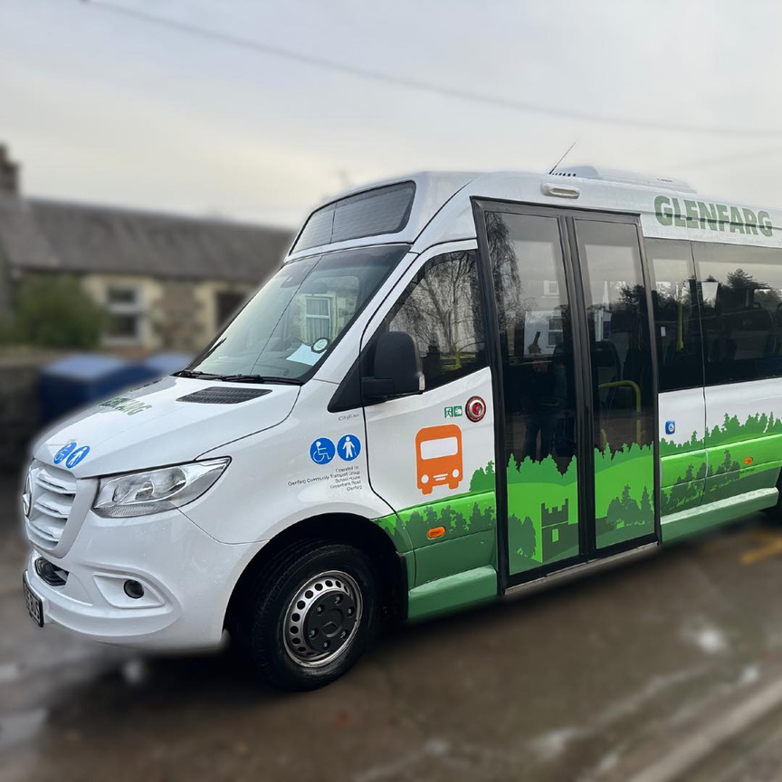
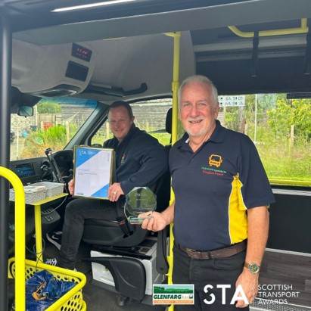
Glenfarg Community Transport Group
- The 55 Bus!!!!

Slide 84
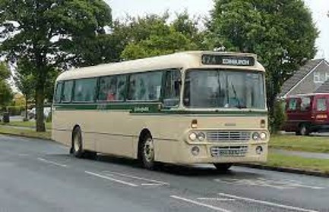
A bit of history…
Familiar Story…
Regular, frequent service before de-regulation
55 Perth to Edinburgh via Glenfarg, hourly plus
Motorway replaced railway, Glenfarg bypassed in 70s
Slow decline in village, loss of hotels, library, post office, the bank, all but one shop
Gradual reduction in bus service, to 2 hourly, loss of evening service > decline in numbers
2020 bus service withdrawn by Stagecoach
Earnside Coaches - 2 hourly to Kinross, two services a day to Perth, with gaps am and pm
2022 notice given that Bus service was being withdrawn again due to Earnside retirement…
55

Slide 85
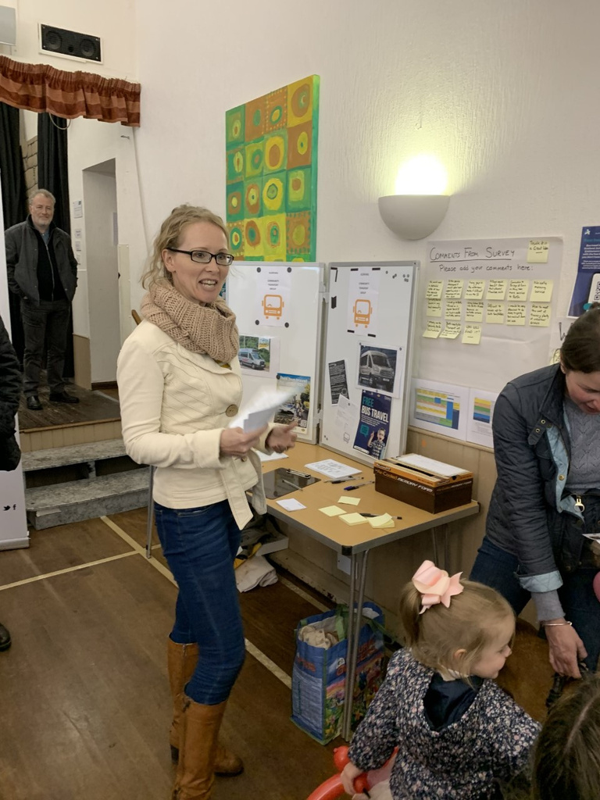
So, what to do? Panic?
Still a strong sense of Community in the village
By luck we had an embryonic Community Transport Group
We had borrowed a minibus from Perth & Kinross Council to run social outings and support clubs
The Community Council had already started gathering information – surveys, focus groups about Public Transport
We had started recruiting volunteers, MiDAS training for the Community Bus
We became a SCIO (Scottish Charity)
In October 2022, we decided that we wouldn’t have our bus service withdrawn for a third time…
And that we would do it ourselves and design a service that worked for US

Slide 86
What our feedback told us…
Before:
Service not frequent enough (2 hrly, 4hrly)
Gaps in service – not regular. Late start 0915.
Inconvenient route – only 2 stops in Glenfarg, all around the houses everywhere else
Haphazard connections – not reliable
Time in town – too short or too long (Goldilocks)
Onward journey difficult due to wrong stop eg to hospital
Kids were limited to school bus times
Rigid route
Bus was perceived to be expensive
The new 55 Bus service from 01/04/2023
Hourly service – Glenfarg to Kinross
First bus 0710 to connect with Ember E1 to Edinburgh at Kinross P&R (arr 0849)
Flexible route with “wiggles”
20-minute, 1-hour-20min etc stopovers
Kids no limited to school bus – after school club
“Affordable” fares: 10-journey ticket for £10
From 01/01/2024
Extension to Perth, through route
Better connections at KinrossP&R and Perth
Much more convenient for Kids (Bus Pass)

Slide 87

We received lots of support and advice…
  Community Transport Association
  Community Transport Glasgow
  Perth & Kinross Council
  Local Councillors
  MSPs

Slide 88





Funding:
  Charities:
  Smarter Choices Smarter Places
  Lottery
  Roberston Foundation
  Lochelbank & Binn Windfarms
  PKC Grants
  Uncle Tom Cobley and All Grants
  Fares – Cash and Credit/Debit Cards
  Concession Cards:
    <22 = between 45% and 85% single fare
    >60 = 55% single fare
  Network Support Grant = £0.14 per km
  Perth & Kinross Council Subsidy

Slide 89
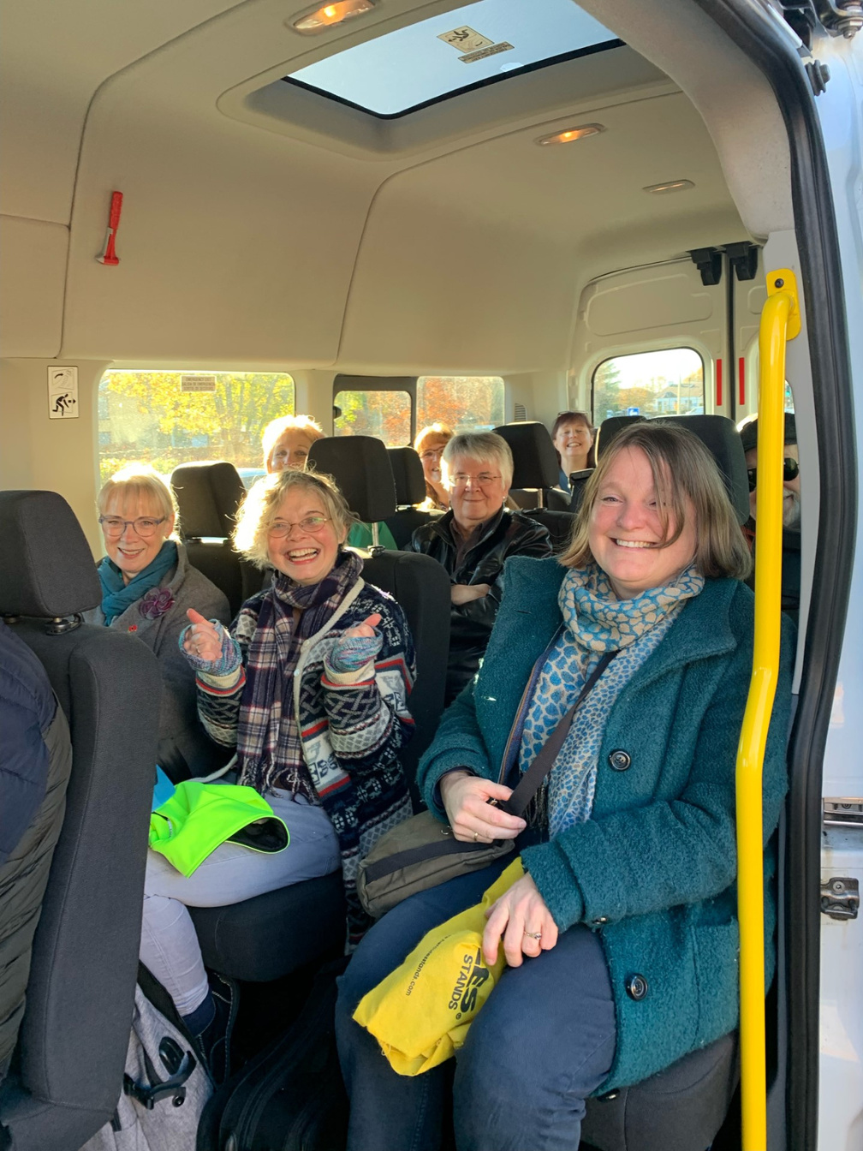
But, the best advice that we were given:
COMMUNITY TRANSPORT IS NOT ABOUT BUSES - IT’S ALL ABOUT PEOPLE…

Slide 90

What Community Transport looks like:

Slide 91
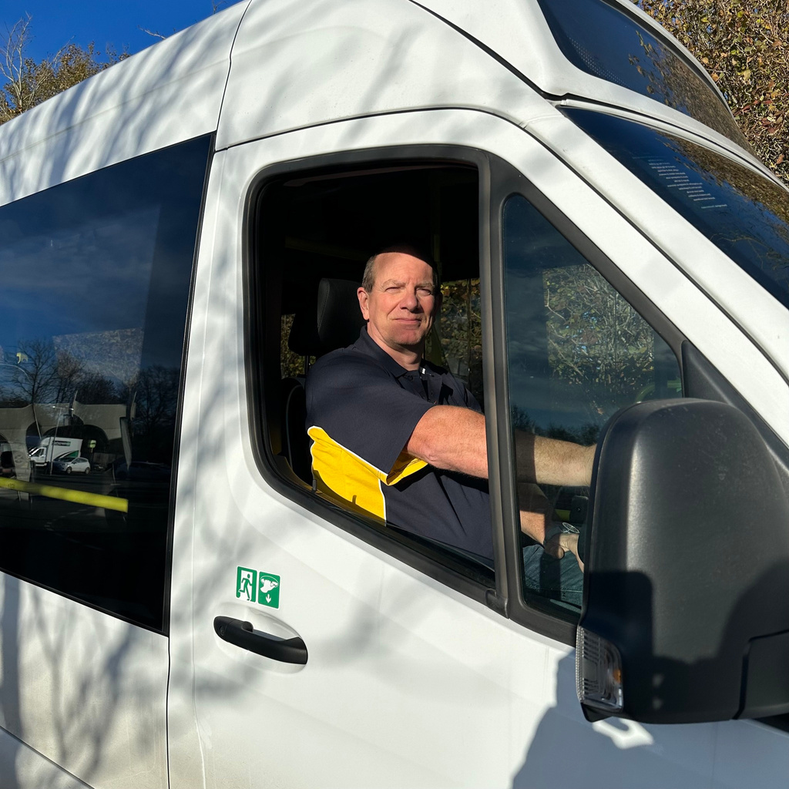
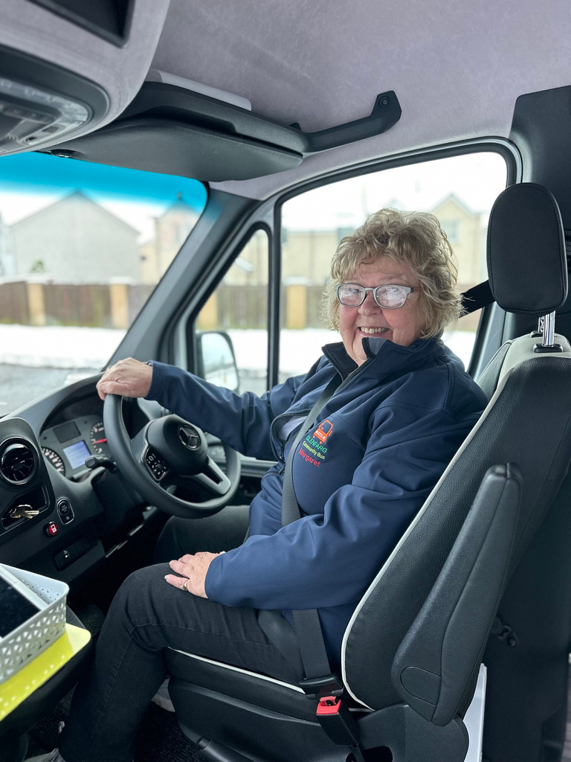





Our Drivers – all 24 of them…

Slide 92





Our Passengers:
Lots of them…

Slide 93
So Back to the Award and the criteria…
How did we do it?
Increase Passenger Numbers:
April 2023 – 120 passenger journeys / week
June 2023 – 250 passenger journeys / week
Dec 2023 – 500 passenger journeys / week
Jan 2024 – 800 passenger journeys / week
Jun 2024 – 1000 passenger journeys / week
Aug 2024 – 1100 passenger journeys / week
Nov 2024 – 1600 passenger journeys / wk
(Further extension to Tillicoultry in Sep 24)
Demonstrate Modal Shift
In an area previously reliant on the car, we were able to produce evidence from several families that had been able to reduce number of cars per household/not had too by an extra car
Members of the Community are able to stay when life events may have previously necessitated a move…
This was due to the increased frequency, low cost, punctuality and reliability…

Slide 94

So Back to the Award and the criteria…
How did we do it?
Customer Satisfaction
With a strong presence on Social Media platforms and increasing followers, friends, members etc we were able to demonstrate very positive reviews and feedback
Any negative comments are taken as important learning points and have been used in subsequent training and planning

Slide 95

So Back to the Award and the criteria…
How did we do it?
Reliability
Due to the support of the whole community in this venture we have been able to develop an enviable reputation for reliability and punctuality
We have three new wheelchair accessible minibuses with a “standby” minibus
Our extended team of drivers and WhatsApp group allows rapid intervention if there are any events threatening the service, eg punctures, breakdowns, vomiting children!!!
We get them involved young….

Slide 96





The Glenfarg Model:
  Registered Charity – not for profit organisation
  Community Led
  Service bus – salaried / professional drivers
  Community Bus – volunteer drivers
  (The Comm Bus volunteers are also the 55 “bank”)
  Active Travel – walking and wheeling
  Public Social Partnership with PKC
  Connections at P&R and in Perth
  Could be replicated in any community…

Slide 97



Press Coverage: Courier, BBC Scotland News, Guardian, STV News, BBCMorning Live, CTA, Scottish Parliament,

Slide 98



But still like a Bus picture…

Slide 99



Slide 100

Setting up a Community Transport hub, impact it has made for operators.
ROXANE DACEY
COMMUNITY TRANSPORT OFFICER
SWANSEA CVS
#CT24

Slide 101


Slide 102

Building relationships across
multiple sectors.
BARRY ARMSTRONG
CHIEF OPERATING OFFICER
WATBUS
#CT24

Slide 103


WATBus Community Transport
Barry Armstrong
Chief Operating Officer

Slide 104

WATBus
  Wansbeck
  Accessible
  Transport

Slide 105

Evolution

Slide 106


Slide 107



Slide 108

Our location
WATBreak
WATBus HQ
You are here!
WATBike

Slide 109



Beautiful Beaches

Slide 110




Amazing Castles

Slide 111
The Development of WATBus
  Reliant on grant funding
  Secure regular income source
  2015 Home to School SEN contracts
  Growth and development
  Invest surplus back into the community

Slide 112
Community investment
  Free travel to some of our regular and longstanding elderly groups
  Heavily discounted travel for youth and community groups
  Cheap self-drive hire for registered user groups
  Free transport for all community groups over the Christmas period

Slide 113
Thinking outside the box
Not for profit projects
  WATBike
  WATBreak

Slide 114
The aims of WATBike
  Health and wellbeing
  Getting adults back on bikes
  Sustainable, carbon-free travel

Slide 115
What we do
  Take in donated bikes to refurbish and sell on
  Children's bikes start from £10
  Adult's bike start from £50
  Fully equipped cycle service Centre
  Cycle maintenance classes
  Free weekly volunteer lead guided rides for adults

Slide 116
In the past year
  We have given away 20% of our donations to charitable causes
  Donated 20 bikes to Scotswood Garden Project
  Provided over 100 children's and adult's bikes to Ukrainian refugees

Slide 117

WATBreak
  A Three-bed, Six-berth static caravan
  Located in the stunning coastal town of Amble (30 miles north of Newcastle)
  Nominal fee per night
  Available to all individuals, groups and organisations associated with WATBus

Slide 118
Building relationships
  Within the community
  Board of trustees
  Other local community transport charities
  Local authority

Slide 119
Challenges
  Keeping up with demand
  Growth (capacity/space)
  New Labour Budget
  Volunteer and trustee recruitment
  D1 drivers
  Costs

Slide 120
Top Tip!
Building relationships across multiple sectors is key to understating the geographical area you serve.
This will help you understand where you can be most effective and reach the people who most need your services.

Slide 121
  WATBus
  WATBike
  WATBreak
  WATNext...?

Slide 122

Workshop Three
Please take your seats for the afternoon workshops
#CT24

Slide 123
Workshop Three:
Vehicle Solutions
DAVID KELLY
SCOTLAND DIRECTOR, CTA
#CT24

Slide 124

Workshop Three:
Dive into best practices for maintaining and purchasing vehicles for community transport services.
FRED JAMES
MINIBUS OPTIONS
#CT24

Slide 125





Slide 126

Covid Semi-conductor shortage Russia conflict Israel conflict GSR2 (General Safety
Regulations)
CAFE regulations
ZEV mandate
Increased cost of energy,
labour, materials
WHAT HAPPENED TO THE MINIBUS MARKET

Slide 127

Who Are They How Many Mobility Level What Are They Taking
PEOPLE

Slide 128

Size & Weight Engine
Options
BASE VEHICLE

Slide 129

ACCESS
Side Rear

Slide 130

Seating Wheelchair Stowage
ACCOMMODATION

Slide 131

Comfort Driver Consideration
Critical Equipment
EXTRAS

Slide 132


THANK YOU

Slide 133

Workshop Three:
Dive into best practices for maintaining and purchasing vehicles for community transport services.
TRISTAN SCAIFE
BUSINESS CHOICE DIRECT
#CT24

Slide 134



Business Choice Direct
Your Voice in the Insurance Market.
‹#› | Impound Quote & Buy

Slide 135

Agenda for today.
  Who are Business Choice Direct (BCD)
  Market update – Why are all insurance prices going up?
  How BCD will be your voice.
  How can you help us, to help you?
‹#› | Impound Quote & Buy

Slide 136
Who are Business Choice Direct?
  Your official insurance partner for Motor Insurance – From single vehicles, to fleets, to car clubs……Each time you insure, we donate!
  Over 10 years experience with 20,000 clients - The majority of which sit within transport and logistics. Including the partnerships space.
  Part of the Benefact group of companies - where all available profits go to charities and good causes.
  Based in Eastleigh Hampshire - where our team of over 60 people can support you by phone, email, WhatsApp, and face to face.
  Access to whole UK insurance market - including Lloyds of London.
  No limits – Electric vehicles, 1 vehicle or hundreds!
‹#› | Impound Quote & Buy

Slide 137

Market update.
‹#› | Impound Quote & Buy

Slide 138
Market update – Cause and Effect.
Cause
Effect
  Vehicle & part supply issues.
  Cost of labour.
  Pirates.
  Most motor insurers losing money for 17 of the last 20 years.
  Electric vehicles.
  Investors withdrawing from insurers.
  Products being withdrawn from the market.
  Specialist insurers ceasing trading.
  Options for customers reducing.
  Some smaller brokers losing insurance agencies.
  = Higher premiums for all or
  = No insurance available. (Car Clubs mainly effected)
‹#› | Impound Quote & Buy

Slide 139





How can we be your voice?
  Educate the market – On how well CT’s are run and the fact claims are low.
  Spread the ‘MIDAS’ Message – Insurers don’t seem to be aware of it and/or what it does to reduce claims.
  Leverage the partnership – We’ve already agreed some exclusive discounts for CTA members quoting via BCD.
  Increase competition – We need two break up the ‘big two’
‹#› | Impound Quote & Buy

Slide 140
How can you help us to help you?
  Challenge your current broker….do they have access to all markets, do they only work exclusively with one?
  Give us a shot…..The more policies we see, the more information we have, the better the chance to win the CTA new deals, discounts and products.
  Don’t wait to renewal…we can advise you today, sort new policies where needed, and transfer over your existing policy at no cost to you.
  Each time you insure, we donate – That’s partnership.
‹#› | Impound Quote & Buy

Slide 141

Workshop Three:
Dive into best practices for maintaining and purchasing vehicles for community transport services.
JAMES HOOKER
HARRIS MAXUS
#CT24

Slide 142




R Chamberlain
Nov 24
27th Nov 2024
James Hooker
Public Sector Manager
SAIC MAXUS

Slide 143


BACKGROUND to BEV
R0
G152B192
R93
G189B221
  In 2019 manufacturers set a CAFÉ (Corporate Average Fuel Economy) Target.
  In 2024 ZEV (Zero emission vehicle) mandate introduced
    2 Target Average Co2 per unit
    Mix of Volume separated between cars and vans
    Cars = 22% for 24 80% by 2030
    Vans = 10% for 24 70% by 2030
R212
G237B247
R137
G137B137
R87
G87
B87
R255
G255B255
R0
G0
B0
‹#›

Slide 144
LCV BEV Consideration
R0
G152B192
R93
G189B221
Myth Busting
Ease of Driving
Charging requirement?
Costs
R212
G237B247
Driver/Staff Buy in
Telematics
Power availability
R137
G137B137
LEARNINGS
Ease of driving
Range requirement
Home charging
R87
G87
B87
R255
G255B255
EPTO / VTL
Payload
Mission planning
Savings
R0
G0
B0
Driver training
Grants
‹#›

Slide 145


Maxus LCV Range 2024
R0
G152B192
R93
G189B221
R212
G237B247
R137
G137B137
R87
G87
B87
Product
Payload from 4.8 to 12.9m3 / L3 L4 Chassis Cab / window option
Payload from 1045kg to 1710kg
Range from 230 – 325 KM (198 miles)
Drive – FWD / RWD / AWD
Towing - <2.8t
Dealer Network – 70 Aftersales points
R255
G255B255
R0
G0
B0
‹#›

Slide 146

Investment in batteries
R0
G152B192
R93
G189B221
R212
G237B247
R137
G137B137
R87
G87
B87
R255
G255B255
R0
G0
B0
‹#›

Slide 147

Active and Passive Safety
R0
G152B192
R93
G189B221
R212
G237B247
R137
G137B137
R87
G87
B87
R255
G255B255
R0
G0
B0
‹#›

Slide 148

R0
G152B192
R93
G189B221
R212
G237B247
R137
G137B137
R87
G87
B87
R255
G255B255
R0
G0
B0
‹#›

Slide 149








R0
G152B192
R93
G189B221
R212
G237B247
What can Maxus Offer you?
R137
G137B137
R87
G87
B87
R255
G255B255
R0
G0
B0
‹#›

Slide 150

Workshop Three:
Dive into best practices for maintaining and purchasing vehicles for community transport services.
STEPHEN CAVE
DVSA
#CT24

Slide 151



Enforcement Policy

Slide 152
DVSA is an executive agency of Department for Transport.
Responsible for keeping Britain moving, safely and sustainably.
  helping you through a lifetime of safe and sustainable journeys
  helping you keep your vehicle safe to drive
  protecting you from unsafe drivers and vehicles

Slide 153
How we do it
Helping you through a lifetime of safe driving
2.9 million theory tests
1.54 million car driving tests
120,000 vocational driving tests
700,000 visits to the new Highway Code online
Protecting from unsafe vehicles and drivers
163,000 enforcement encounters
29,000 serious defects and offences detected on HGV
335 fraudulent MOT testers stopped
Help keep your vehicle safe to drive
40 million MOT certificates issues 20,000 VTS 60,000 NTs
750,000 heavy vehicles tested 600 ATFs 500 VSAs

Slide 154
Vehicle Approvals Individual vehicle approval, motorcycle single vehicle approval, & notifiable alterations
Vehicle safety branch Vehicle safety recalls
Market surveillance unit Monitor transport products for compliance
Approved Driver Instructor (ADI) Instructor training and assessment
Collision investigation Heavy vehicle post collision examination
Operator licensing enforcement Investigations, site visits and fleet compliance checks
Roadside enforcement activities Target non-compliant operators

Slide 155
Enforcement policy
  Interpret legislation
  Consult with government, industry and trade bodies
  Produce a workable policy
  React to legal challenges and case results

Slide 156

Publications

Slide 157

Roadside enforcement

Slide 158


Brakes

Slide 159


Load security

Slide 160


Overweight

Slide 161


Maintenance investigations
  Forward planning
  Missed or late safety inspection
  Driver defect reporting systems
  Maintenance contracts
  Tyre and wheel management
  Transport manager CPD

Slide 162
Bridge strikes
  Height marker included in Guide to Maintaining Roadworthiness
  Check of vehicle height on driver walkaround check
  Enforcement sanctions available
  Using the data to explore other options

Slide 163
The future

Slide 164



Self-driving vehicle
Our focus
DVSA CAMS Research Team
Self-driving in limited conditions
Self-driving anywhere

Slide 165


New equipment
On-board diagnostics
  Identifying manipulation of emission software
  Speed limiter settings
  Post collision examination work
  Warning lights
  PN meter
  Measuring particulates from the exhaust

Slide 166


Any Questions?
enforcementpolicy@dvsa.gov.uk

Slide 167
Thank you
Keeping Britain moving, safely and sustainably

Slide 168
Reflections on CT24
ALAN JONES
CHAIR
#CT24

Slide 170
THANK YOU
Please join us for drinks and networking at the bar.
We hope you have a safe journey home.
#CT24

