Slide 1



WELCOME TO
CT24
THE VOICE OF
THE PASSENGER
THE MEZZANINE

Slide 2
Workshop Two:
Improving access to
health & social care
NICOLA MITCHELL
DEVELOPMENT OFFICER, CTA
#CT24

Slide 3
Workshop Two:
Partnership Working Within Health Transport
HOWARD GUNN
HEAD OF TRANSPORT SERVICES
CONNEX COMMUNITY SUPPORT
#CT24

Slide 4

Howard Gunn
Head of Transport Services
Tel: 01298 23970
www.connex.org.uk
transport@connex.org.uk

Slide 5







Partners in delivery
Funded and supported by
Partners

Slide 6

Partnership working in Health Transport
Covering the entire Western half of Derbyshire Since October 2017.
  Transported over 68,139* passengers
  Travelled over 832,857* miles
  * Reporting during Covid pandemic was temporarily suspended

Slide 7
Advantages of Partnerships
  Established organisations that know their locality.
  Passionate volunteers wanting to help their own community.
  Centralised telephone booking telephone number.
  Opportunity to share costs and resources across partnership.
  Early intervention and support, prevents a problem becoming a crisis.

Slide 8
Challenges
  Recognition by funders that we are not a cheap Taxi or Public Transport service. We deliver so much more.
  Negotiating a funding solution to suit each delivery partner.
  Maintaining enough volunteers to deliver the services and hit KPI’s.
  Trust in partner agencies to do all they can to hit their KPI’s.
  SUSTAINABILITY!

Slide 9
Thanks for listening.
For more information.
Tel: 01298 23970
www.connex.org.uk
transport@connex.org.uk

Slide 10
Workshop Two:
Connecting Yorkshire: Community Transport for Health and Wellbeing
DAVID WILLIAMS
TRANSPORT COORDINATOR,
HEALTH FOR ALL
#CT24

Slide 11
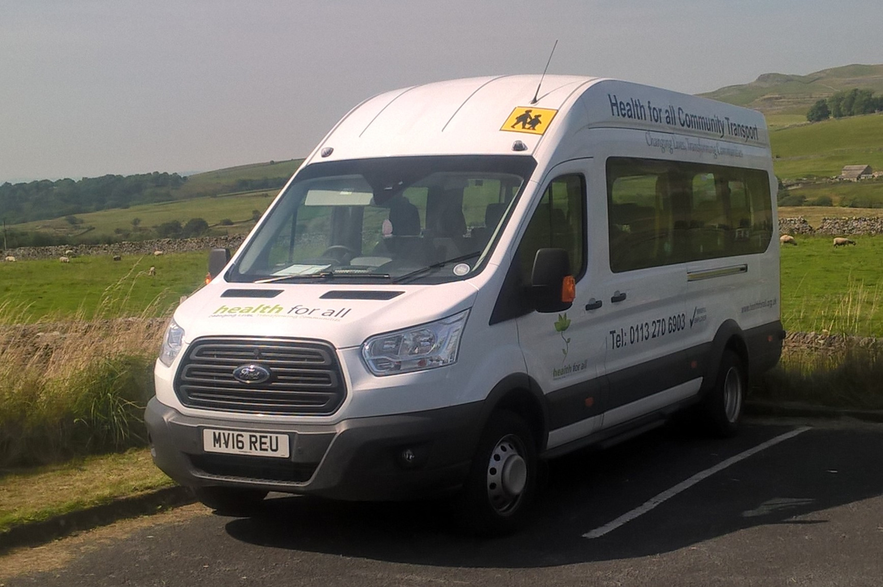

Connecting Yorkshire:
Community Transport for Health and Well Being

Slide 12
Introduction
  Background of Health For All (HFA)
    Established in 1991 to address health inequalities in South Leeds.
  The Community Transport Project
    Established in 2003
  Stats from 2023
    3,700 Trips ; drove 77,000 miles; carried 30,000 passengers
  This presentation
    How we operate our Community Transport Service
    Benefits v Challenges of Community Transport

Slide 13
Who can use our Services
  We operate under Section 19 Permits
  Registered Customers only
  Schools
  Groups and Organisations from disadvantaged backgrounds

Slide 14
Benefits of Community Transport
  Type of Journeys we cover
    Hospital Transport
    Access to sporting facilities and events
    Educational Visits
    Access to the Countryside
    Giving access to the Countryside – working with Yorkshire Dales
      Co-fund various trips throughout the year
    Wheel Chair Accessible Vehicles
      Provides wheel chair users some independence
    Local Schools
      Supporting Extra Curricular activities

Slide 15
Challenges of Community Transport
  Maintaining a sustainable level of business
    Cyclical nature
  Reliable and Competent Drivers
    Contract v Volunteers
  Robust Booking Database
    Excel Spreadsheet v Proper database
  Operational Costs
    Actual Cost v Affordable service
  Vehicle Reliability
    Ownership v Lease
  Risk Management
    Health and Safety Compliance

Slide 16
Summary and Top Tip.
  Running a CTA
    Hopefully Benefits outweigh the Challenges
    “When you lose your usefulness, you fall off the radar and you become invisible, if it wasn’t for Community Transport that would be me ….You make me feel included”
  TOP TIP to take away with you.
  We should not underestimate the vital role that Community Transport has in reducing social isolation and loneliness as well as improving the Health and well being our Communities

Slide 17
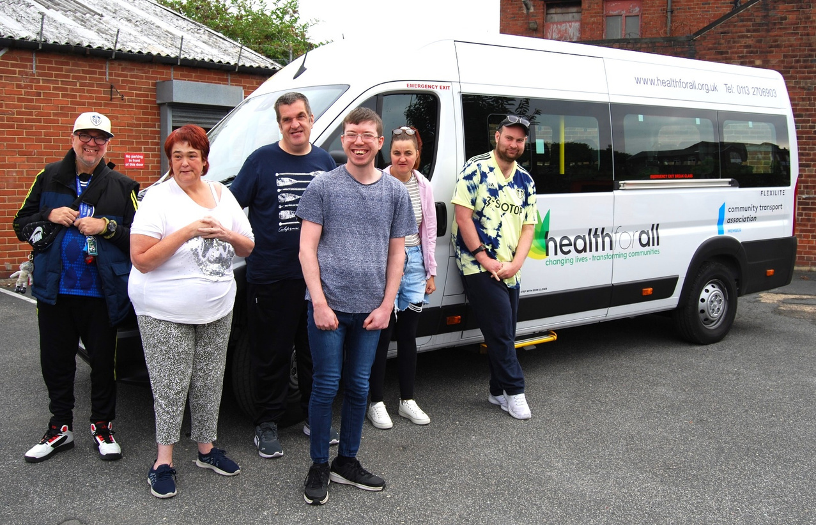
Thank You

Slide 18
Workshop Two:
Building Bridges: Strengthening Community Transport Through
Partner Engagement
DENISE CARMICHAEL
CEO, BORDERS WHEELS
#CT24

Slide 19


Denise Carmichael, Chief Executive Officer – Borders Wheels

Slide 20
Building Bridges: Strengthening Community Transport Through Partner Engagement
  Borders Wheels offers accessible and affordable community transport for anyone who has difficulty using public transport through ill health, disability or age and for whom no private transport is available.
  What can it be used for? Shopping Trips/Visits to family and friends/Outings and excursions
  Getting to meetings/Links to other transport (Rail/Bus)
  Health Appointments/Transport to respite care
  Community or activity group trips - In fact, anything you like!

Slide 21
Building Bridges: Strengthening Community Transport Through Partner Engagement - Our Fleet
  We have 17 Vehicles currently
  In the main the fleet is Diesel with three EV Vehicles
  We work the fleet across locality Boundaries
  We book trips across locality Boundaries
  We also have drivers using their own cars

Slide 22
Building Bridges: Strengthening Community Transport Through Partner Engagement - Our Fleet
  Mostly Volunteers – some are paid
  Ages 25-79
  We train them all in MiDAS (Mini bus Drivers Awareness Scheme)
  We can also talk to other organisations about their drivers training needs
  We offer our Drivers – First Aid/Dementia Friendly/Manual Handling/All accessibility/RNIB Sight Awareness/PVG – more will be added to our portfolio to ensure continued personal development

Slide 23
Building Bridges: Strengthening Community Transport Through Partner Engagement
Since coming into post in March I worked quickly to establish a partner network – it is so much easier to collaborate and develop shared solutions:
SCOTLAND
    Community Transport Association
    SESTran (The South East Of Scotland Transport Partners)
    SusTrans (National Cycle Network)
    Transport Scotland
    The Active Travel Network

Slide 24
Building Bridges: Strengthening Community Transport Through Partner Engagement
BORDERS
  Scottish Borders Council – Fleet Team
  Royal Voluntary Services
  All housing associations in the Scottish Borders
  NHS Borders and NHS Borders Patient Transport
  Borders Older People’s Forum and the Borders Older People's Partnership
  SOSE (South Of Scotland Enterprise)
  All care homes

Slide 25
Building Bridges: Strengthening Community Transport Through Partner Engagement
I sit on the following forums:
  Integrated Joint Health Board
  Borders Older Peoples Forum
  Borders Older Peoples Partnership
  Each locality Community Engagement Forum
  Ability Borders
  The Hike and Bike Hub

Slide 26
Building Bridges: Strengthening Community Transport Through Partner Engagement
BORDERS
  Scottish Borders Council – Fleet Team
  Royal Voluntary Services
  All housing associations in the Scottish Borders
  NHS Borders and NHS Borders Patient Transport
  Borders Older People’s Forum and the Borders Older People's Partnership
  SOSE (South Of Scotland Enterprise)
  All care homes

Slide 27
Building Bridges: Strengthening Community Transport Through Partner Engagement
  Tweeddale Thrift Shop - Innerleithen
  Roxburgh Thrift Shop – Jedburgh
    No shop boundaries – shared plan and vision
    Will become Borders Wheels branded
  Run by Shop Managers and Volunteers
    Shops are currently undergoing a BIG makeover
    Lovely to have local charity shops giving to a local charity

Slide 28
Any Questions?

Slide 29
Thank you
Denise Carmichael,
CEO Borders Wheels
ceo@borderswheels.org.uk
0300 456 1985

Slide 31
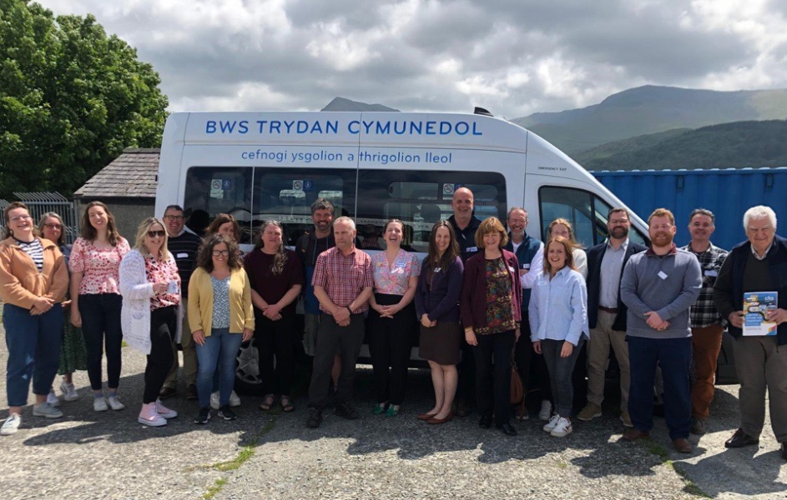



Lunch
Please help yourself to refreshments downstairs in the main space .
#CT24

Slide 32


Slide 33
Workshop Four:
Cyber Security how can you
safeguard against digital threats.
CAROLINE WHITNEY
DIRECTOR FOR ENGLAND, CTA
#CT24

Slide 34
Workshop Four:
Cyber Security how can you
safeguard against digital threats.
MARTIN WILSON
NORTH EAST BUSINESS RESILIENCE CENTRE
#CT24

Slide 35












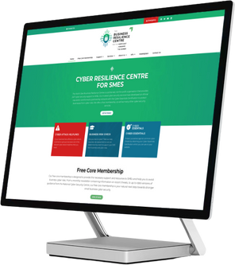
CTA 24: The voice of the passenger
DI Martin Wilson, BSc, MSc, PGCE
Cole Mohammed
This document/email contains no sensitive information and can be circulated without restrictions

Slide 36







What are we going to discuss?
Agenda
Introductions
Hackers Mindset
Phishing, Passwords, Remote Working
AI, OSINT & QA
Who am I?
Cyber-Attack impacts
What are their motivations
What do they want from my business
Artificial Intelligence
Digital Footprints
Cyber Essentials
Free Core Membership
Student Services
Any Questions?
What is phishing, things to look out for
How to secure my accounts with passwords and MFA
How work safely remotely
This document/email contains no sensitive information and can be circulated without restrictions

Slide 37
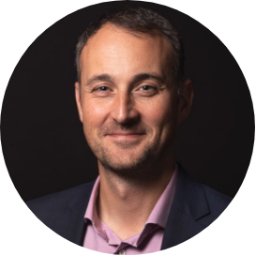






Who are
we?
Martin Wilson, BSc, PGCE, MSc
Head of Student Services
Serving Police Officer 👮‍♀️
Interesting Fact: Surfer 🏄‍♂️
Kryptonite: Coffee ☕️
Cole Mohammed
NEBRC Student
Northumbria Uni 👨‍🎓
Interesting Fact: Bench Press 🏋️‍♀️
Kryptonite: Hot Drinks ☕️
This document/email contains no sensitive information and can be circulated without restrictions

Slide 38
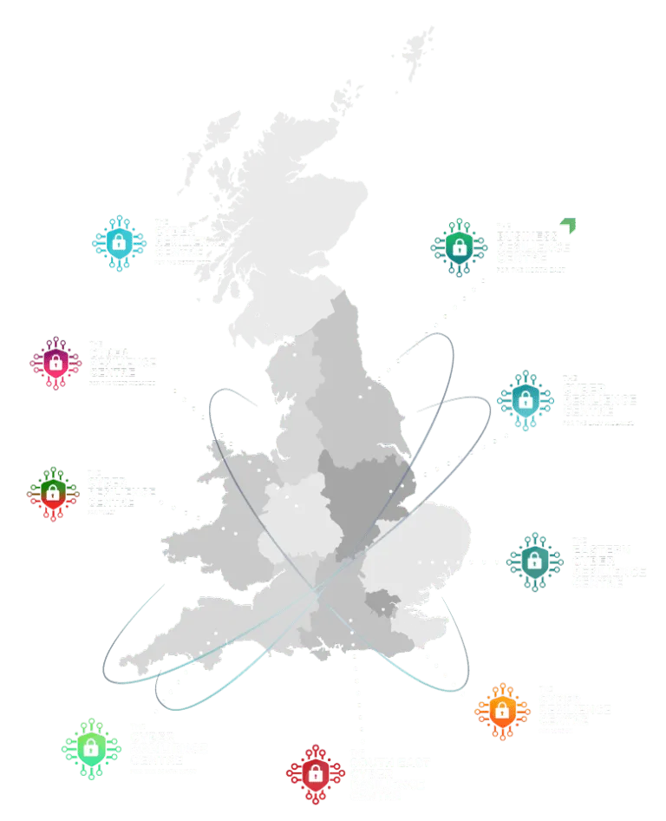
NEBRC
The CRC Network
Trusted - Not for Profit -
Low-Cost Cyber Security Services
Policing, Academia, and Private Sector
Collaborating to protect small businesses from cybercrime

Slide 39








NEBRC
Talent pipeline
Reduce vulnerability
PROFESSIONAL, affordable services
This document/email contains no sensitive information and can be circulated without restrictions

Slide 40




Why
SMEs?
50%
SMEs are
They make up
99.2%
60%
They contribute to half of the total UK turnover
of all UK businesses
An SME is any organisation that has fewer than 250 employees and a turnover of less than €50 million
of all UK employment
This document/email contains no sensitive information and can be circulated without restrictions

Slide 41






SME attacks
50% are attacked at least weekly
Many do not recover
What is the HUMAN cost?
This document/email contains no sensitive information and can be circulated without restrictions

Slide 42
How vulnerable do you think your business is to a cyber attack?
?
Not very because....
I am too small to be of interest
I have nothing worth stealing
I am only 1 year in
Cyber criminals only go after larger businesses
I have the latest tool......
This document/email contains no sensitive information and can be circulated without restrictions

Slide 43


Motivation
WE WANT YOUR DATA
This document/email contains no sensitive information and can be circulated without restrictions

Slide 44








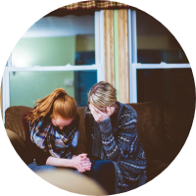
50% of SMEs Experience at Least One Incident a Week
Why am
I here?
IT Service Loss
Financial Loss
Reputational Damage
Theft of Data
Data Encryption
Fines
Company Valuation
Mental Health

Slide 45

Sometimes Attacks Result in Some Business Ceasing To Trade
Impacts

Slide 46

🤔

Slide 47
Motivation
WE WANT YOUR DATA

Slide 48

The Scams Change…But 3 Things Never Change!
Phishing
Phishing vs Spear Phishing vs Whaling
The scam changes but the 3 things they want you to do never change
3 things: click on the link, open an attachment or divulge information
Motivation: Want your login details, want to deliver malware, want your data
Use tried and tested psychological cues to action
This document/email contains no sensitive information and can be circulated without restrictions

Slide 49

Length, uppercase, lowercase, numbers, and special characters? 🤷‍♂️ Let's think like a bad guy...😈
Hackers
log in

Slide 50
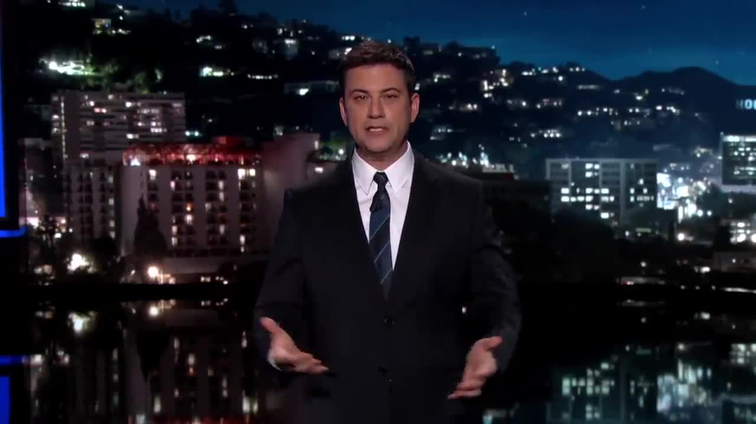

Passwords
How not to authenticate 🤦‍♀️

Slide 51
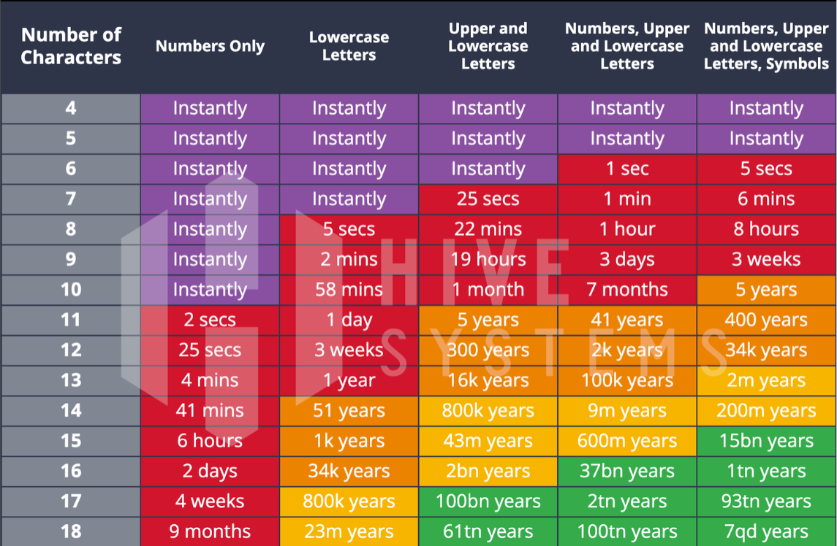
Passwords, Password Managers, MFA

Slide 52


Slide 53
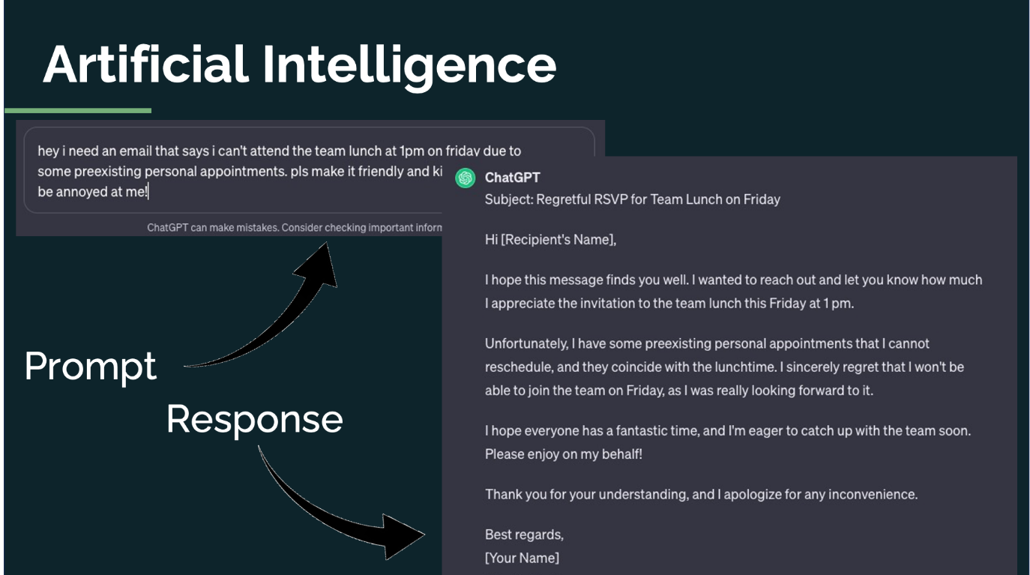

Slide 54
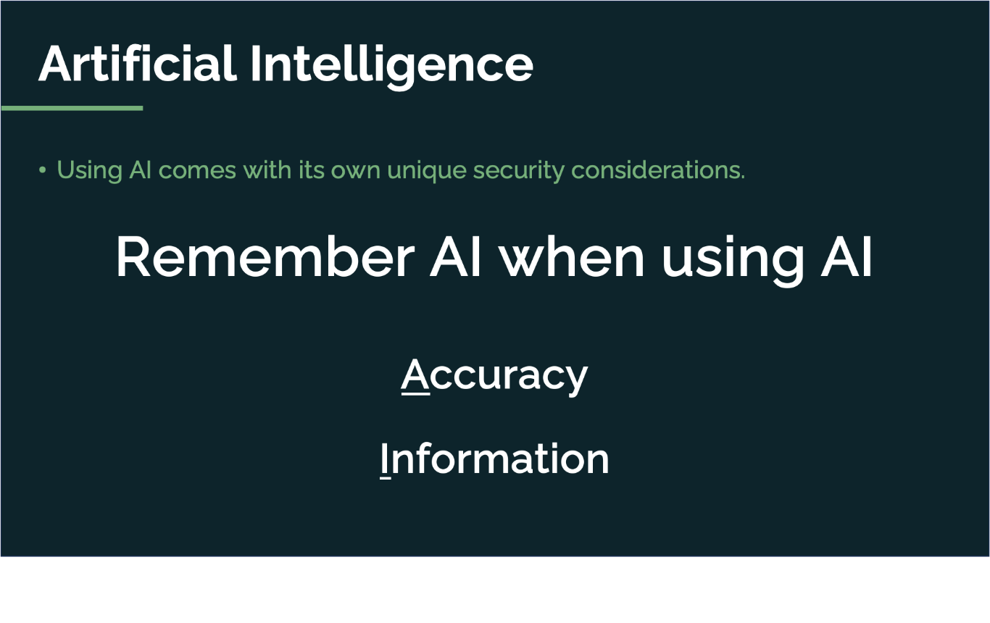

Slide 55
AI Chat Bots & Video Calls
🤖
  AI driven chatbot has been detected during multi-agency video calls
  Teams, Zoom and Google
  Creates AI generated summaries, transcripts, playback
  Provides details related to speech coaching (speed of speech, sentiment analysis, etc).
  What the 1,554 apps do with the information? Who it is shared with, etc?
  Could they constitute a data breach?

Slide 56
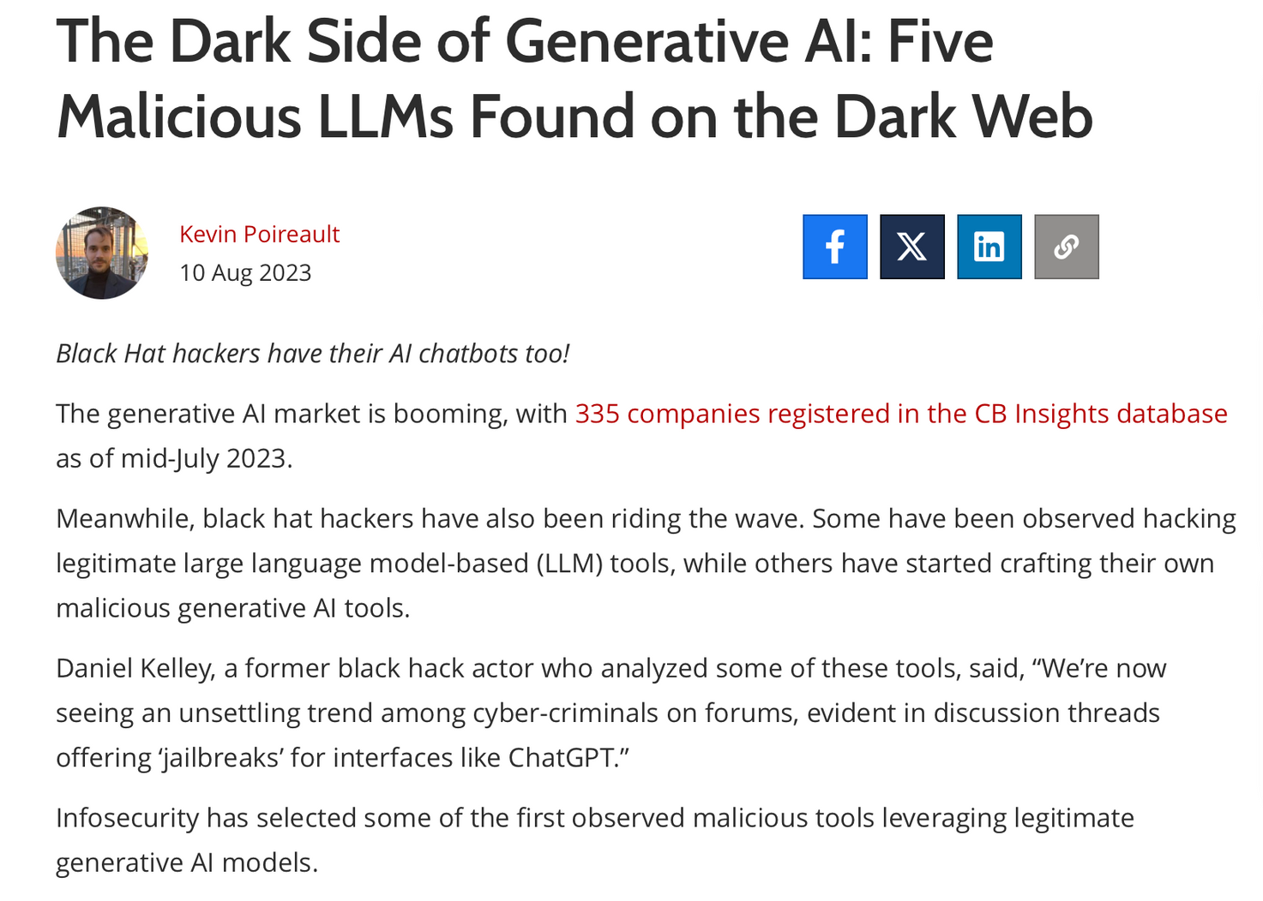
🤖

Slide 57
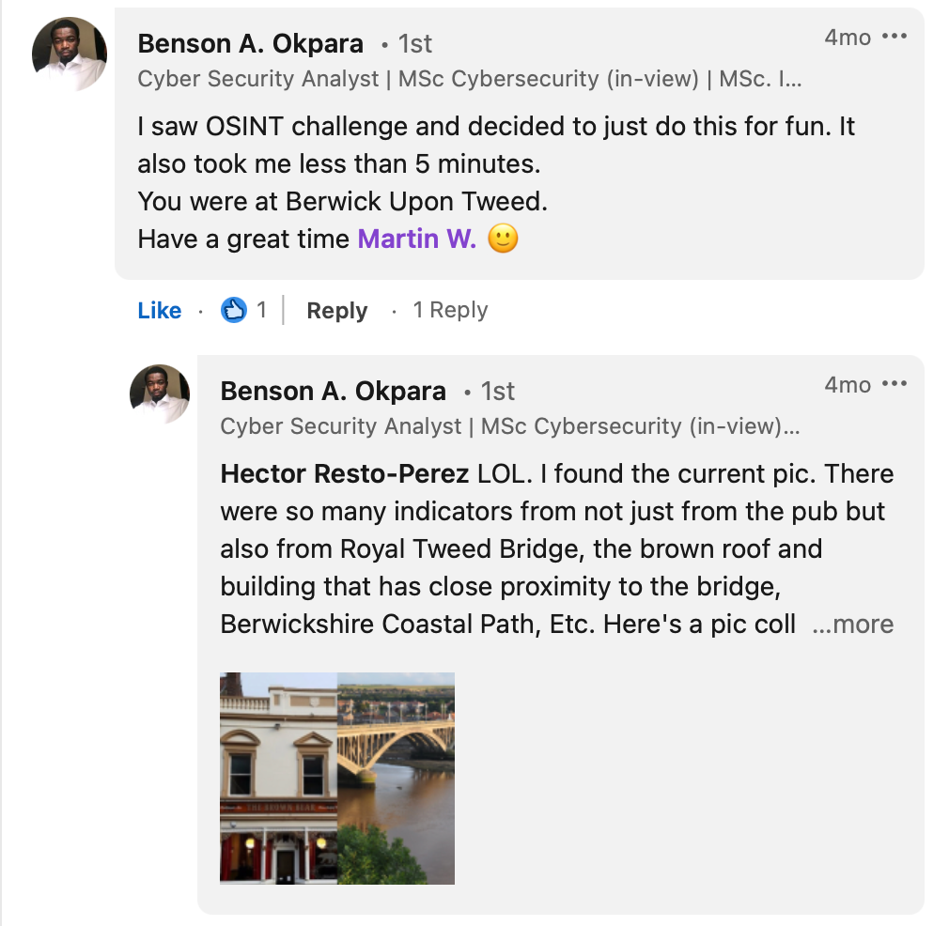
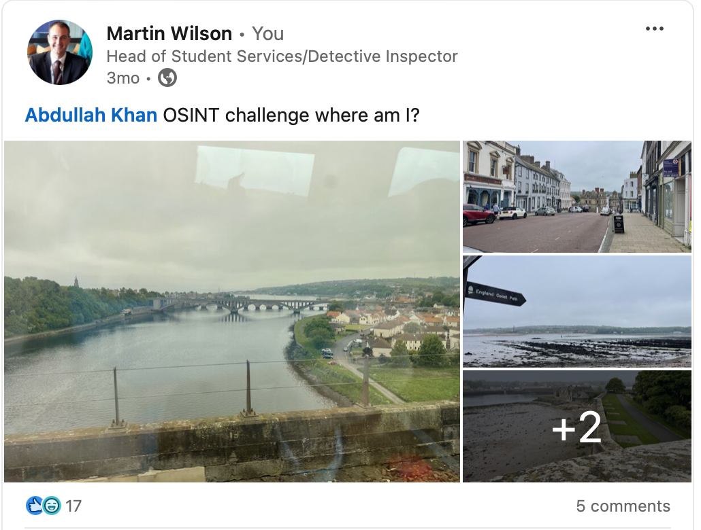
Social media within minutes….
LinkedIn

Slide 58
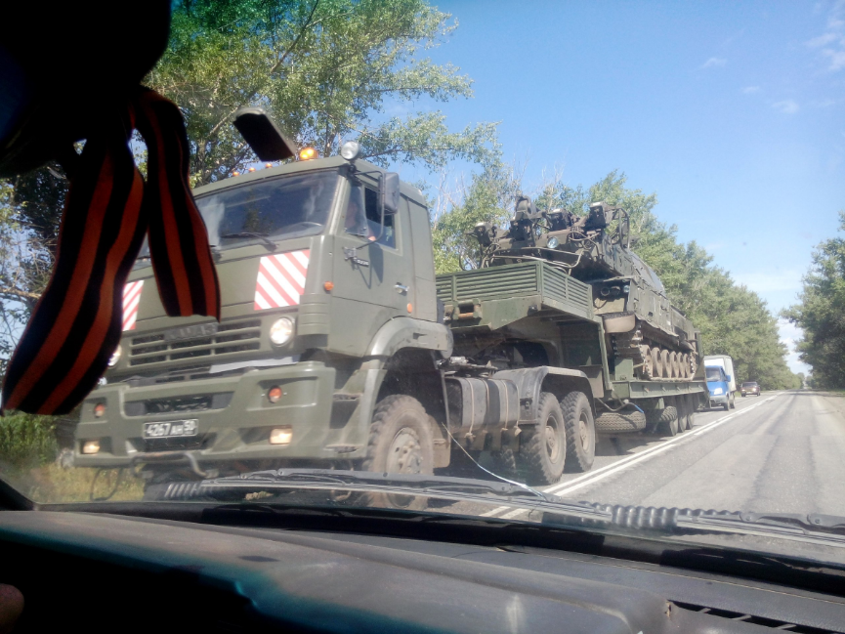
👣

Slide 59
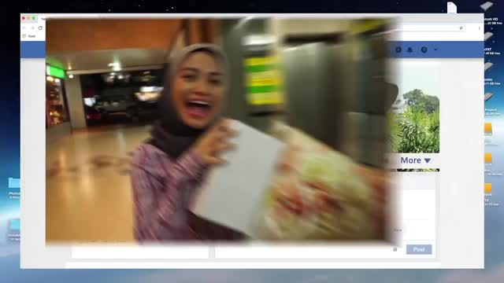
But how do they discover the information about their targets?
Footprint

Slide 60







The trail of data we leave behind as we use digital services
👣
Social Media Activity
Location Data
Websites (contact us)
Companies House
What others post/share about us
The image/photo itself

Slide 61



The Efficacy of Cyber Essentials
✅
This document/email contains no sensitive information and can be circulated without restrictions

Slide 62

Five Key Controls
🛂
This document/email contains no sensitive information and can be circulated without restrictions

Slide 63

Defence in Depth
NEBRC
Layers
Password - Strong and unique
MFA - Is enforced, different types?
Settings - Geolocation Restrictions
Settings - Access Controls
Training - Regular
Reporting - Users?
Golden Rule - Login your own way!
This document/email contains no sensitive information and can be circulated without restrictions

Slide 64



How can the NEBRC help?

Slide 65

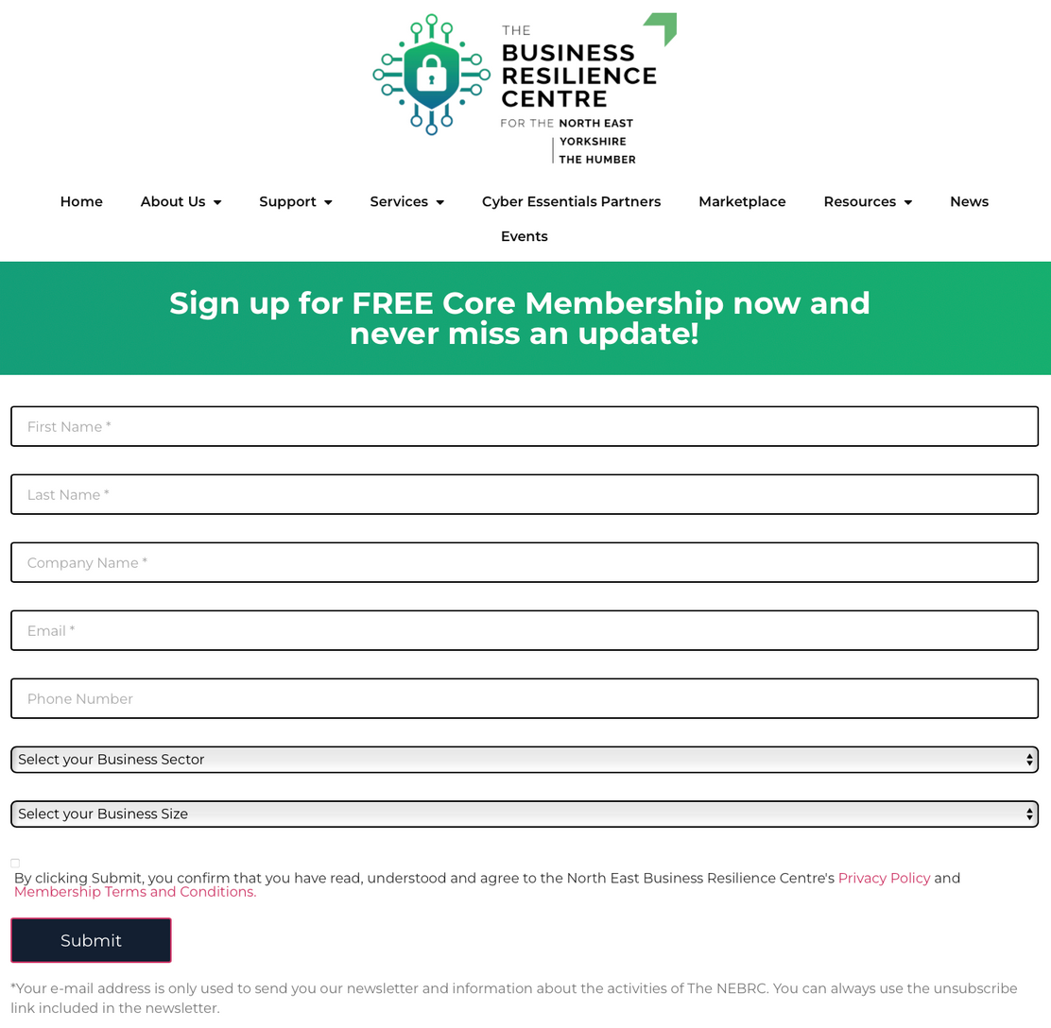
Core Membership

Slide 66










The Student Services
NEBRC
Policy Review
External Vulnerability Assessment
Internal Vulnerability Assessment
Web Application Vulnerability Assessment
Training
Internet Investigations

Slide 67











Feedback
27ᵗʰ of November 2024
THANK YOU FOR LISTENING
Any Questions
enquiries@nebrcentre.co.uk | www.nebrcentre.co.uk
@NEBRCentre
enquiries@nebrcentre.co.uk
@NorthEastBusinessResilienceCentre

Slide 68
THANK YOU
Please make your way downstairs to the main space for closing remarks and refreshments.
#CT24

